Slide 1


Slide 2

Introduction

Slide 3
Introduction
Achieved
What is C#?
C# is pronounced "C-Sharp".
It is an object-oriented programming language created by Microsoft that runs on the .NET Framework.
C# has roots from the C family, and the language is close to other popular languages like C++ and Java.
The first version was released in year 2002. The latest version, C# 13, was released in November 2024.
C# is used for:
Mobile applications, Desktop applications, Web applications, Web services, Web sites, Games, VR, Database applications, And much, much more!
www.bacancytechnology.com
Notes:
https://www.geeksforgeeks.org/introduction-to-c-sharp/

Slide 4
Introduction
Achieved
Why Use C#?
It is one of the most popular programming language in the world.
It is easy to learn and simple to use.
It has a huge community support.
C# is an object oriented language which gives a clear structure to programs and allows code to be reused, lowering development costs.
As C# is close to C, C++ and Java, it makes it easy for programmers to switch to C# or vice versa.
www.bacancytechnology.com

Slide 5
Variable and Data Type
Achieved
What is a Variable?
A variable is like a storage box where you can keep data. Each variable has:
Name: So you can refer to it (e.g., age, name).
Data Type: So the computer knows what kind of data it will store (e.g., a number, a letter, or a true/false value).
Value: The actual data you put into the box (e.g., 25 for age).
What is a Data Type?
Data type tells the computer what kind of data a variable will store. In C#, you must specify this when you create a variable. It ensures the variable behaves correctly (e.g., numbers can be added, and strings can be combined).
www.bacancytechnology.com

Slide 6
Variable and Data Type
Achieved
Allowed in Variable Names
You can start the name with a letter(a-z, A-Z).
You can use numbers in the name, but not as the first character.
You can use underscores in the name, and it can even be the first character.
C# is case-sensitive, so myVariable and MyVariable are different variables.
Not Allowed in Variable Names
Variable names cannot contain spaces. Use camelCase or underscores instead.
Variable names cannot begin with a number.
You cannot use special characters like @, #, $, %, ^, &, *, etc.
C# has certain reserved keywords (e.g., int, class, namespace, etc.) that you cannot use as variable names directly.
Hyphens are not allowed in variable names. Use underscores instead.
www.bacancytechnology.com

Slide 7
Data Type
Achieved
C# Data Type | Range | Size | .NET Type | Notes
byte | 0 to 255 | 1 byte | System.Byte | For small positive numbers.
sbyte | -128 to 127 | 1 byte | System.SByte | For small signed integers.
short | -32,768 to 32,767 | 2 bytes | System.Int16 | For small integers.
ushort | 0 to 65,535 | 2 bytes | System.UInt16 | For small positive integers.
int | -2,147,483,648 to 2,147,483,647 | 4 bytes | System.Int32 | Most commonly used for whole numbers.
uint | 0 to 4,294,967,295 | 4 bytes | System.UInt32 | For large positive numbers.
long | -9,223,372,036,854,775,808 to 9,223,372,036,854,775,807 | 8 bytes | System.Int64 | For very large integers.
www.bacancytechnology.com

Slide 8
Data Type
Achieved
C# Data Type | Range | Size | .NET Type | Notes
ulong | 0 to 18,446,744,073,709,551,615 | 8 bytes | System.UInt64 | For very large positive numbers.
float | ±1.5 × 10⁻⁴⁵ to ±3.4 × 10³⁸ | 4 bytes | System.Single | For floating-point numbers. Use f suffix (e.g., 3.14f).
double | ±5.0 × 10⁻³²⁴ to ±1.7 × 10³⁰⁸ | 8 bytes | System.Double | More precise than float. Default for decimal numbers.
decimal | ±1.0 × 10⁻²⁸ to ±7.9 × 10²⁸ | 16 bytes | System.Decimal | Best for financial or monetary calculations. Use m suffix (e.g., 12.99m).
char | Any single Unicode character | 2 bytes | System.Char | Use single quotes (e.g., 'A').
bool | true or false | 1 byte | System.Boolean | For logical operations.
www.bacancytechnology.com

Slide 9
Nullable Types
Achieved
Nullable Types in C#
In C#, nullable types allow variables of value types (like int, double, bool, etc.) to hold a special value called null.
Why Use Nullable Types?
A database query may return null for an empty field.
A variable that hasn't been assigned a value yet might need to signify "no value."
How to Declare a Nullable Type
int? age = null; // Nullable integer
Nullable<int> age = null; // Equivalent to int?
www.bacancytechnology.com

Slide 10

readonly and const
Achieved
const
A constant is a value that is known at compile-time and never changes.
It must be initialized when declared.
It is implicitly static, meaning it belongs to the type (class/struct) rather than any instance.
const data_type field_name = value;
readonly
A readonly field can only be assigned once, either:
At the time of declaration.
Or, in the constructor (for instance fields).
readonly data_type field_name;
const
readonly
required
www.bacancytechnology.com

Slide 11
Operators
Achieved
Arithmetic Operators
Addition (+), Subtraction (-), Multiplication (*), Division (/), Modulus (%)
Why Use Arithmetic Types?
Arithmetic operators used to perform mathematical operations on numbers.
Example
Addition (+), Subtraction (-), Multiplication (*), Division (/), Modulus (%)
Examples: a + b, a * b
www.bacancytechnology.com
www.bacancytechnology.com

Slide 12
Operators
Achieved
Logical Operators
AND (&&), OR (||), NOT (!)
Why Use Logical Types?
Logical operators are used for checking conditions
Example
Examples: a && b, !a
www.bacancytechnology.com
www.bacancytechnology.com

Slide 13
Operators
Achieved
Assignment Operators
AND (&&), OR (||), NOT (!)
Why Use Assignment Types?
Basic Assignment (=): a = 5
Compound Assignments: Add and Assign (+=), Subtract and Assign (-=), Multiply and Assign (*=), etc.
Example
Examples: a += 5, b *= 2
www.bacancytechnology.com
www.bacancytechnology.com

Slide 14
Arrays and Collections
Achieved
Array Basics
Fixed-size collection of elements
Elements are of the same type
Accessed by index
Lists and Dictionaries
Lists: Dynamic-sized collection
Dictionaries: Key-value pairs for efficient lookups
www.bacancytechnology.com

Slide 15
Methods and Functions
Achieved
Methods are generally the block of codes or statements in a program that gives the user the ability to reuse the same code which ultimately saves the excessive use of memory, acts as a time saver and more importantly, it provides a better readability of code. So basically, a method is a collection of statements that perform some specific task and return the result to the caller. A method can also perform some specific task without returning anything.
Method Declaration: Method declaration means the way to construct method including its naming.
Syntax: <Access_Modifier> <return_type> <method_name>([<param_list>])
www.bacancytechnology.com

Slide 16
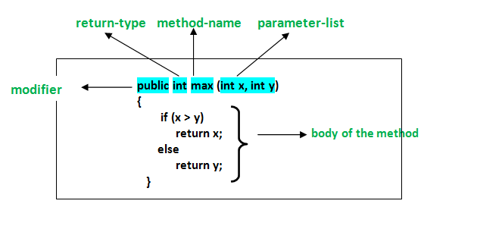
Methods and Functions
Achieved
In C# a method declaration consists of the following components as follows :
Modifier: It defines access type of the method i.e. from where it can be accessed in your application. In C# there are Public, Protected, Private access modifiers.
Name of the Method: It describes the name of the user defined method by which the user calls it or refer it. Eg. GetName()
Return type: It defines the data type returned by the method. It depends upon user as it may also return void value i.e return nothing
www.bacancytechnology.com

Slide 17
Methods and Functions
Achieved
Body of the Method: It refers to the line of code of tasks to be performed by the method during its execution. It is enclosed between braces.
Parameter list: Comma separated list of the input parameters are defined, preceded with their data type, within the enclosed parentheses. If there are no parameters, then empty parentheses () have to use out.
Method Signature: Method Signature is defined by mainly two parameters(number of parameters, type of the parameters and order of the parameters), One of them is Method Name and second one is its Parameter list.
Method Signature: Method Signature is defined by mainly two parameters(number of parameters, type of the parameters and order of the parameters), One of them is Method Name and second one is its Parameter list.
Method Naming: Name of a method or a function in any programming language whether in C++ or Java or C# holds great importance and is mainly used in order to call that method for its execution. For example, findSum, computeMax, setX and getX etc.
www.bacancytechnology.com

Slide 18
Methods and Functions
Achieved
There are certain pre-defined rules for naming methods which a user should follow:
The method name must be some kind of Noun or a verb.
It’s naming should be done in such a way that it must describe the purpose of that method.
The first letter of the method name can be either a small letter or a Capital letter, however, it is recommended to use the capital one.
Advantages of using the Methods:
There are many advantages of using methods. Some of them are listed below:
It makes the program well structured.
Methods enhance the readability of the code.
It provides an effective way for the user to reuse the existing code.
It optimizes the execution time and memory space.
www.bacancytechnology.com

Slide 19
Exception Handling
Achieved
Exception occurs during execution of program and it breaks normal flow of program execution. If it is not handled It can cause the application to stop working.
C# provides built-in support to handle these exceptions using try-catch blocks.
C# has its own set of specific exceptions which can be used in an application.
Some of them are:
NullReferenceException,
ArgumentOutOfRangeException,
InvalidCastException,
FileNotFoundException,
InvalidOperationException etc.
www.bacancytechnology.com

Slide 20
Exception Handling
Achieved
try{
// Any suspected code that can raise exceptions should be put inside this block.
}
catch {
// This block is an exception handler block where some action such as logging and auditing an exception can be performed
}
finally {
// his block will always be executed whether an exception raised or not. Usually, this block should be used to release resources, e.g., to close any stream or file objects that were opened in the try block.
}
www.bacancytechnology.com

Slide 21
Exception Handling
Achieved
class Program {
static void Main(string[] args) {
try
{
Console.WriteLine("Enter your number: ");
int num = Convert.ToInt32(Console.ReadLine()); //input from User is twenty instead of 20
Console.WriteLine($”Result is ${Math.Sqrt(num)}”);
Console.ReadKey();
}
catch (Exception ex) {
Console.WriteLine($"There is something wrong, please look at this message: {ex.Message}");
Console.ReadKey();
}
}
}
www.bacancytechnology.com

Slide 22
Self Learning
Collections and LINQ
Control Flow
Enums and Structs

Slide 23
Collections and LINQ
Achieved
What is a Collection?
In programming, a collection is a data structure used to store, manage, and manipulate multiple items (objects) as a single unit. Collections provide a way to group items, often of the same type, for operations like adding, removing, iterating, and searching.
www.bacancytechnology.com

Slide 24
Collections and LINQ
Achieved
Dictionary<TKey, TValue>
A collection of key-value pairs where keys must be unique.
Use Case: Efficient lookups by key.
var dictionary = new Dictionary<int, string>
{
{ 1, "One" },
{ 2, "Two" },
{ 3, "Three" }
};
if (dictionary.TryGetValue(2, out var value))
{
Console.WriteLine($"Key 2: {value}"); // Output: Key 2: Two
}
www.bacancytechnology.com

Slide 25
Collections and LINQ
Achieved
HashSet<T>
A collection of unique elements that does not allow duplicates.
Use Case: Fast operations like checking existence, adding, or removing elements.
var hashSet = new HashSet<int> { 1, 2, 3, 3 }; // Duplicates are ignored
hashSet.Add(4);
hashSet.Remove(2);
Console.WriteLine(string.Join(", ", hashSet)); // Output: 1, 3, 4
www.bacancytechnology.com

Slide 26
Collections and LINQ
Achieved
LINQ Queries (Language Integrated Query)
Filtering (Where)
Use Case: Filters elements based on a condition.
var numbers = new List<int> { 1, 2, 3, 4, 5, 6 };
var evenNumbers = numbers.Where(n => n % 2 == 0);
Console.WriteLine(string.Join(", ", evenNumbers)); // Output: 2, 4, 6
Ordering (OrderBy/OrderByDescending) Use Case: Orders elements in ascending or descending order.
var names = new List<string> { "John", "Alice", "Bob" };
var sortedNames = names.OrderBy(name => name);
Console.WriteLine(string.Join(", ", sortedNames)); // Output: Alice, Bob, John
www.bacancytechnology.com

Slide 27
Control Flow
Achieved
Conditional Statements
If-else
else-if
Switch-case
Jump Statements
Break
Continue
Return
goto
Loops
For
ForEach
While
Do-While
www.bacancytechnology.com

Slide 28
Enums and Structs
Achieved
An enum type (or enumeration type) is a value type defined by a set of constants of with their underlying numeric type.
To define an enumeration type, use the enum keyword and specify the names of enum members.
www.bacancytechnology.com

Slide 29
Enums and Structs
Achieved
public enum Season
{
Spring,
Summer,
Autumn,
Winter
}
public class EnumConversionExample
{
public static void Main()
{
Season a = Season.Autumn;
Console.WriteLine($"Integral value of {a} is {(int)a}"); // output: Integral value of Autumn is 2
var b = (Season)1;
Console.WriteLine(b); // output: Summer
var c = (Season)4;
Console.WriteLine(c); // output: 4
}
}
www.bacancytechnology.com

Slide 30
In this session
Achieved
What we are learning in this session
Namespaces and Assemblies
Lambda Expressions
Generics
www.bacancytechnology.com

Slide 31
Namespaces and Assemblies
Achieved
Namespaces
A namespace in is a container for classes, interfaces, structs, enums, and delegates, used to organize code logically and avoid naming conflicts.
Key Points:
Syntax: namespace NamespaceName { // members }
Provides a way to group related types (e.g., System.Collections.Generic).
Helps prevent name clashes by isolating identifiers.
Multiple levels of namespaces can be nested.
www.bacancytechnology.com

Slide 32
Namespaces and Assemblies
Achieved
namespace MyApp.Utilities
{
public class Logger
{
public void Log(string message) => Console.WriteLine(message);
}
}
www.bacancytechnology.com

Slide 33
Namespaces and Assemblies
Achieved
Assemblies
An assembly is a compiled code library used for deployment, versioning, and security in .NET. It contains Intermediate Language (IL) code and metadata.
Types of Assemblies:
Executable (EXE): Entry point for applications.
Library (DLL): Reusable components.
Key Components:
Manifest: Metadata about the assembly (name, version, culture, etc.).
IL Code: Compiled .NET code.
Metadata: Descriptions of types, members, and references.
www.bacancytechnology.com

Slide 34
Lambda Expressions
Achieved
Lambda Expressions
A lambda expression is a concise way to represent an anonymous method using the => (lambda) operator.
Syntax:
(parameters) => expression
nums.Where(x => x > 5);
www.bacancytechnology.com

Slide 35
Generics
Achieved
Generic is to allow type to be a parameter to methods, classes, and interfaces.
It enables to create classes, interfaces, and methods that work with different data types without having to define the data type explicitly.
It provides type safety. When a generic class, interface or method is defined, the type parameter that it can work with can be specified.
This ensures that the code will only accept and operate on data types that match the specified type parameter, preventing errors that can occur due to data type mismatches.
C# provides a number of built-in generic types, such as List<T>, Dictionary<TKey, TValue>,
www.bacancytechnology.com

Slide 36
Generics
Achieved
class DataStore<T>
{
private T[] _data = new T[10];
public void AddOrUpdate(int index, T item) {
if(index >= 0 && index < 10) _data[index] = item;
}
public T GetData(int index) {
if(index >= 0 && index < 10) return _data[index];
else return default(T);
}
}
DataStore<string> cities = new DataStore<string>();
cities.AddOrUpdate(0, "Mumbai");
cities.AddOrUpdate(1, "Chicago");
cities.AddOrUpdate(2, "London");
DataStore<int> empIds = new DataStore<int>();
empIds.AddOrUpdate(0, 50);
empIds.AddOrUpdate(1, 65);
empIds.AddOrUpdate(2, 89);
www.bacancytechnology.com

Slide 37
Self Learning
Delegates and Events - Creating and using delegates - Anonymous methods - Events and event handlers
Advanced C# Concepts - Boxing and Unboxing - Type Casting - Extension Methods

Slide 38
Asynchronous Programming
Achieved
Asynchronous Programming
async and await keywords
Task-based asynchronous programming
Parallel processing with Task and Task.Run
Multithreading and Parallel Programming
Using Thread, Task, and Parallel classes
Synchronization mechanisms
Concurrent collections
Key Features:Non-blocking I/O operations
Efficient resource utilization
www.bacancytechnology.com

Slide 39
Asynchronous Programming
Achieved
async: Marks a method as asynchronous, enabling the use of await.
await: Suspends the method execution until the awaited task is complete.
Example
public async Task FetchDataAsync()
{
var data = await GetDataFromAPI();
Console.WriteLine(data);
}
www.bacancytechnology.com

Slide 40
Asynchronous Programming
Achieved
Task Class: Represents an asynchronous operation.
Advantages
Simplified handling of asynchronous code.
Supports cancellation and continuations.
Example
Task<int> task = Task.Run(() => ComputeSum());
int result = await task;
www.bacancytechnology.com

Slide 41
Multithreading and Parallel Programming
Achieved
Definition
Running multiple threads in parallel within the same process.
Key Objectives
Utilize multiple CPU cores.
Improve performance for computationally intensive operations.
Example
Thread t = new Thread(() => Console.WriteLine("Thread Example"));
t.Start();
www.bacancytechnology.com

Slide 42
Multithreading and Parallel Programming
Achieved
Synchronization Mechanisms
Used to avoid data corruption in shared resources.
Mechanisms in C#
lock: Simplest way to synchronize access.
Monitor: Fine-grained control.
Mutex: Inter-process synchronization.
Semaphore: Controls access to a resource pool.
lock(obj)
{
sharedResource++;
}
www.bacancytechnology.com

Slide 43
Introduction
Achieved
Object-oriented programming (OOP) is a way of developing software applications using real-world terminologies to create entities that interact with one another using objects.
OOP makes applications flexible, reusable, well-structured, and easy to debug and test.
The basic building blocks of OOP are classes, methods, properties, and objects.
Classes define the structure of an object, methods represent the behavior of an object, properties hold the data of an object, and objects are instances of a class.
Here are some of the benefits of OOP:
Reusability: Object-oriented programming (OOP) introduces Classes and Objects to promote code reuse. Instead of repeating the same code, you can create a class once and use its object multiple times wherever needed.
www.bacancytechnology.com

Slide 44
Introduction
Achieved
Extensibility: OOP allows you to add new features without rewriting everything. Using concepts like Inheritance you can extend existing code easily.
Simplicity: Unlike traditional modular programming, where code can be scattered and harder to secure, OOP organizes code using Abstraction, Encapsulation, and Polymorphism. This simplifies understanding and enhances security.
Maintainability: Since OOP focuses on Reusability, Extensibility, and Simplicity, it results in clean, organized, and easy-to-maintain code. This improves the overall quality and lifespan of applications.
www.bacancytechnology.com

Slide 45
Classes and Objects
Achieved
Class : A class is a user-defined blueprint that defines both state (properties) and behavior (actions). It serves as a template for creating objects. In C#, a class consists of a name, attributes (properties), and operations (methods).
Object: An object is a specific instance of a class. It brings the class to life and performs actions defined by the class. To access a class's members (attributes and methods), you use an object along with the dot(.) Operator.
Methods: A method represents a particular behavior. It performs some action and might return information about an object, or update an object’s data.
Properties: Properties hold the data temporarily during the execution of an application.
www.bacancytechnology.com

Slide 46
Classes and Objects
Achieved
Ex:
public class Calculator
{
public int CalculateSum(int no1, int no2)
{
return no1 + no2;
}
}
//Creating object
Calculator calObject = new Calculator();
//Accessing Calculator class member using Calculator class object
int result = calObject.CalculateSum(10, 20);
www.bacancytechnology.com

Slide 47
Constructors and Destructors
Achieved
Consructor: It is a special method present inside a class responsible for initializing the variables of that class.
Destructor: A destructor is a special method that is called automatically when an object is destroyed or goes out of scope. It is used to release resources. In C#, a destructor has the same name as the class but is preceded by a tilde (~).
www.bacancytechnology.com

Slide 48
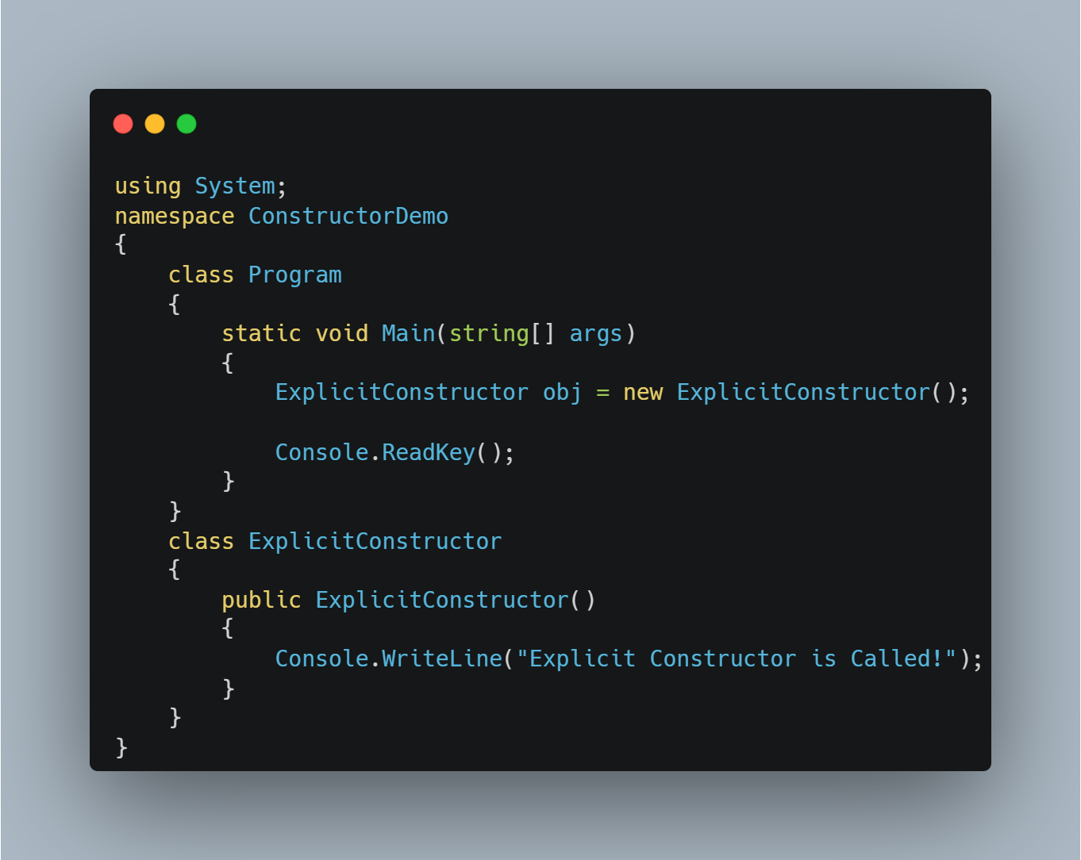
Constructors and Destructors
Achieved
www.bacancytechnology.com

Slide 49
Access Modifiers
Achieved
Modifier | Accessibility
Public | Accessible from anywhere in the application.
Private | Accessible only within the class where it is defined.
Protected | Accessible within the class and by derived classes.
Internal | Accessible within the same assembly (project).
Protected Internal | Accessible within the same assembly or by derived classes.
Private Protected | Accessible within the same class and derived classes, but only in the same assembly.
www.bacancytechnology.com

Slide 50
Encapsulation
Achieved
Property: Properties hold the data temporarily during the execution of an application.
Fields : Fields are variables that directly hold data in a class. Typically kept private to restrict direct access and ensure better control.
Accessors : An accessor is a special block of code in a property that is used to get (retrieve) or set (assign) the value of a private field in a controlled way. Get Accessor : The get accessor is used to retrieve the value of a private field. Set Accessor : The set accessor is used to assign a value to a private field.
www.bacancytechnology.com

Slide 51
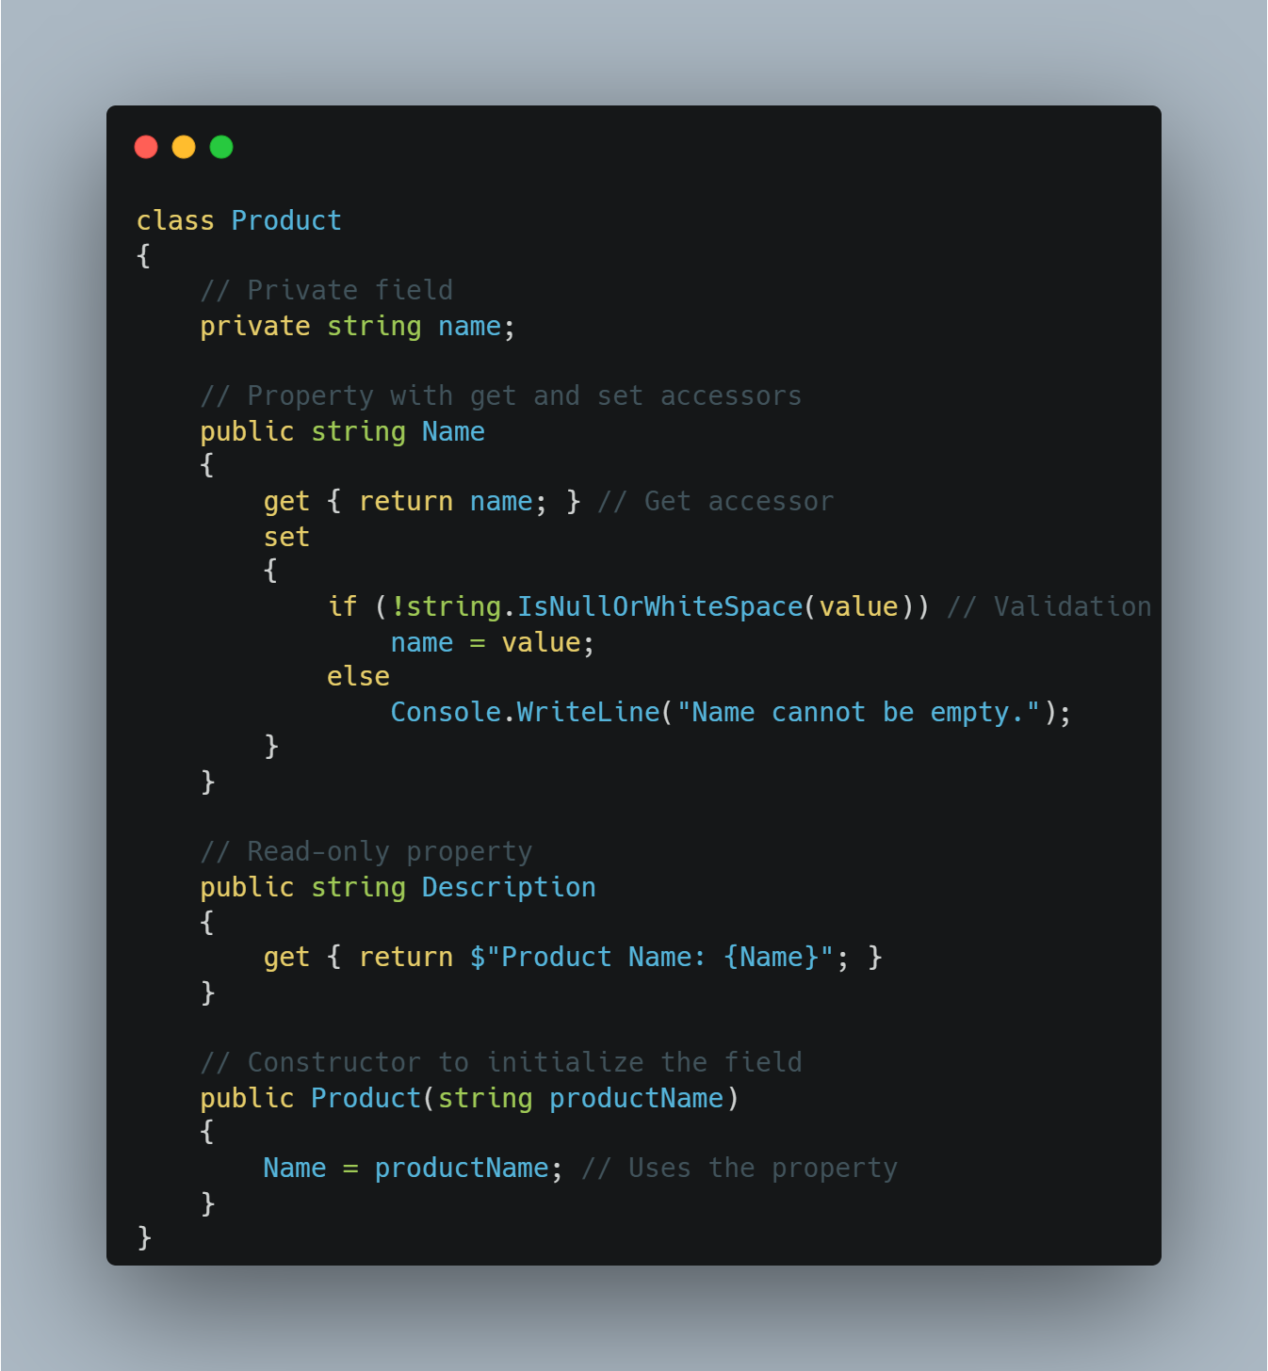
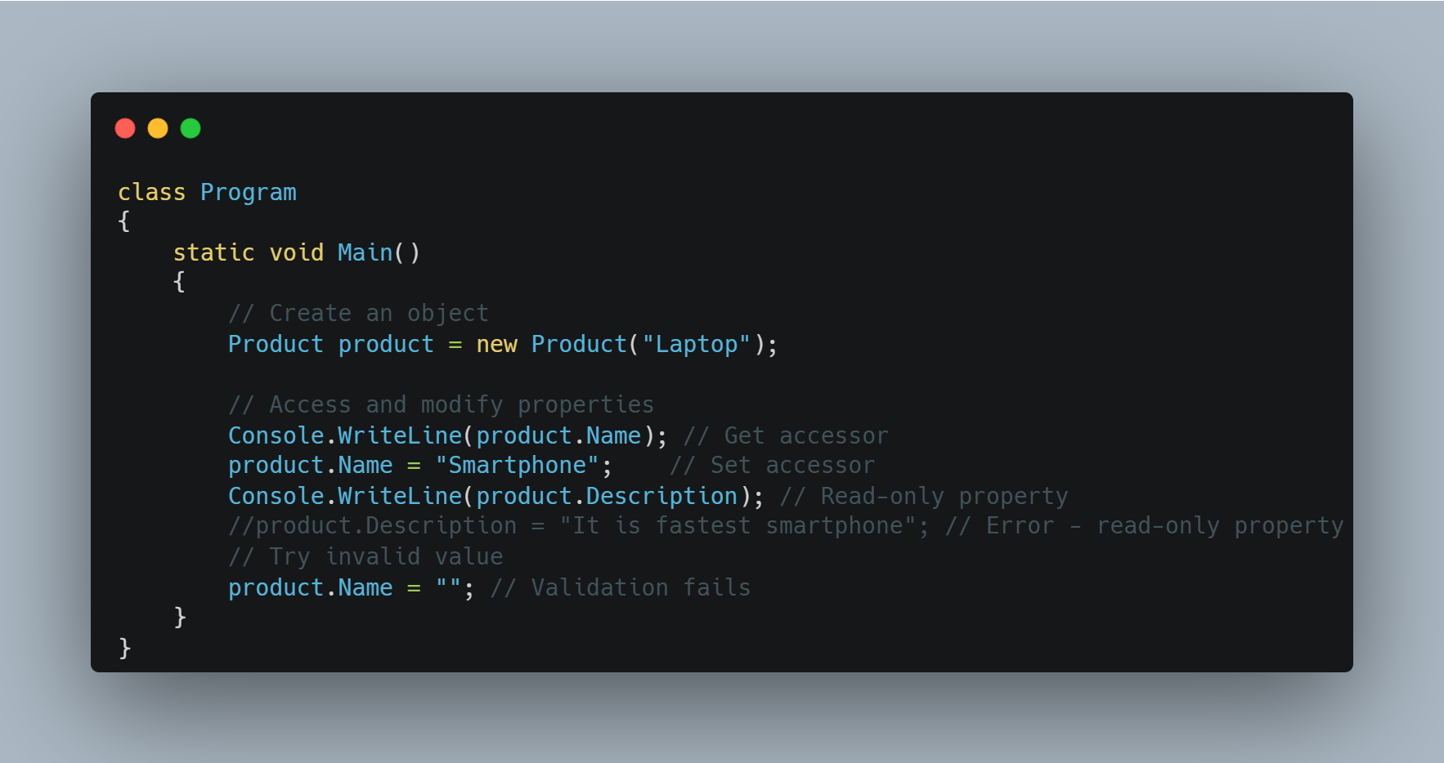
Encapsulation
Achieved
www.bacancytechnology.com

Slide 52
Encapsulation
Achieved
Encapsulation Hides the internal state and functionality of an object and only allows access through a public set of functions.
The Encapsulation Principle in C# is very similar to a Capsule. As a capsule binds its medicine within it, in the same way in C#, the Encapsulation Principle binds the State (Variables) and Behaviour (Methods) into a single unit called class, enum, interface, etc.
Encapsulation hides the data and implementation details show only the required members within a class, thus hiding complexity from other code. No other code needs to know about implementation detail and also can’t modify the code of the class’s data and methods
Most object-oriented programming languages allow you to create classes and their properties and methods along with the access modifiers such as public, private, protected, and internal to show or hide data members and implementation details. Interfaces and abstract classes can also be used for encapsulation.
www.bacancytechnology.com

Slide 53
Encapsulation
Achieved
Advantages of Encapsulation:
Hides data and complexities.
Restrict unauthorized access of data by allowing authorization before data access.
Allow validation before setting data.
Only the author of the class needs to understand the implementation, not others.
Makes applications easy to maintain.
www.bacancytechnology.com

Slide 54
Inheritance
Achieved
In object-oriented programming, inheritance is another type of relationship between classes. Inheritance is a mechanism of reusing the functionalities of one class into another related class.
Inheritance is referred to as "is a" relationship. In the real world example, a customer is a person. In the same way, a student is a person and an employee is also a person. They all have some common things, for example, they all have a first name, middle name, and last name.
To translate this into object-oriented programming, we can create the Person class with first name, middle name, and last name properties and inherit the Customer, Student, and Employee classes from the Person class. That way we don't need to create the same properties in all classes and avoid the violation of the DRY (Do not Repeat Yourself) principle.
Note that the inheritance can only be used with related classes where they should have some common behaviors and perfectly substitutable.
www.bacancytechnology.com

Slide 55
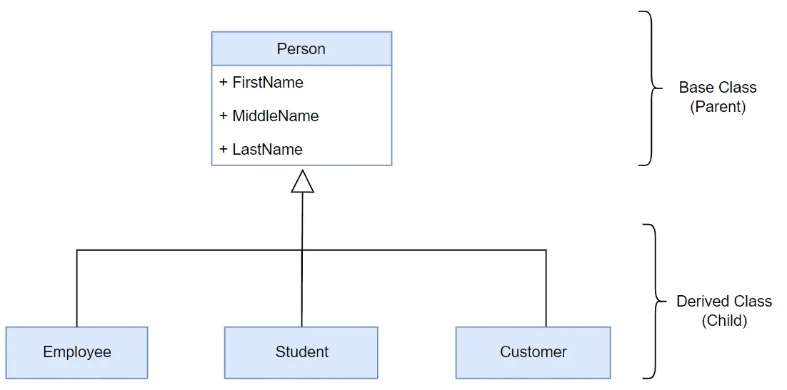
Inheritance
Achieved
Achieved
Example: Class Inheritance in C#
class Person
{
public string FirstName { get; set; }
public string LastName { get; set; }
public string GetFullName(){
return FirstName + " " + LastName;
}
}
class Employee : Person
{
public int EmployeeId { get; set; }
public string CompanyName { get; set; }
}
In C#, use the : symbol to inherit a class from another class. For example, the following Employee class inherits from the Person class in C#.
www.bacancytechnology.com

Slide 56
Inheritance
Achieved
In the above example, the Person class is called the base class or the parent class, and the Employee class is called the derived class or the child class.
The Employee class inherits from the Person class and so it automatically acquires all the public members of the Person class. It means even if the Employee class does not include FirstName, LastName properties and GetFullName() method, an object of the Employee class will have all the properties and methods of the Person class along with its own members.
Note: C# does not allow a class to inherit multiple classes. A class can only achieve multiple inheritance through interfaces.
www.bacancytechnology.com

Slide 57
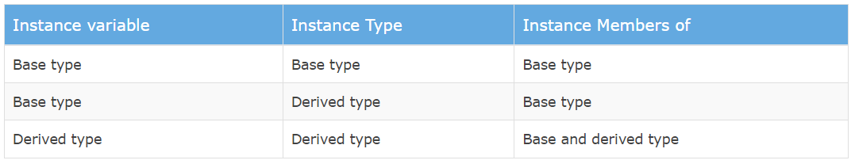
Inheritance
Achieved
Constructors: Creating an object of the derived class will first call the constructor of the base class and then the derived class. If there are multiple levels of inheritance then the constructor of the first base class will be called and then the second base class and so on.
Object Initialization: You can create an instance of the derived class and assign it to a variable of the base class or derived class. The instance's properties and methods are depending on the type of variable it is assigned to. Here, a type can be a class or an interface, or an abstract class.
The following table list supported members based on a variable type and instance type.
www.bacancytechnology.com

Slide 58
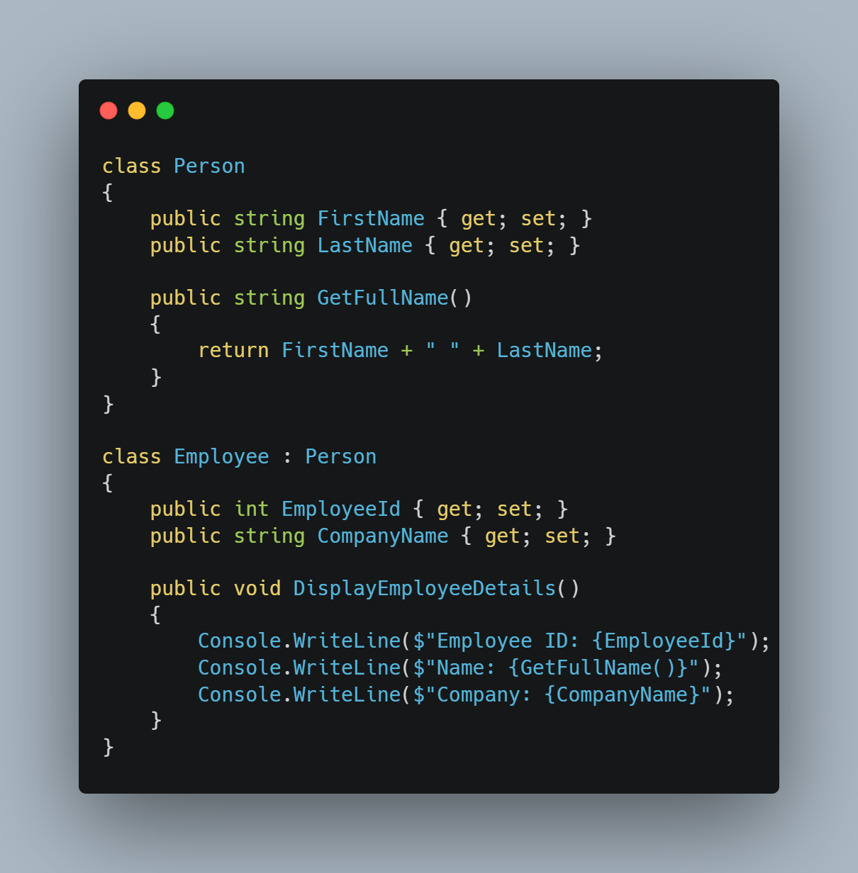
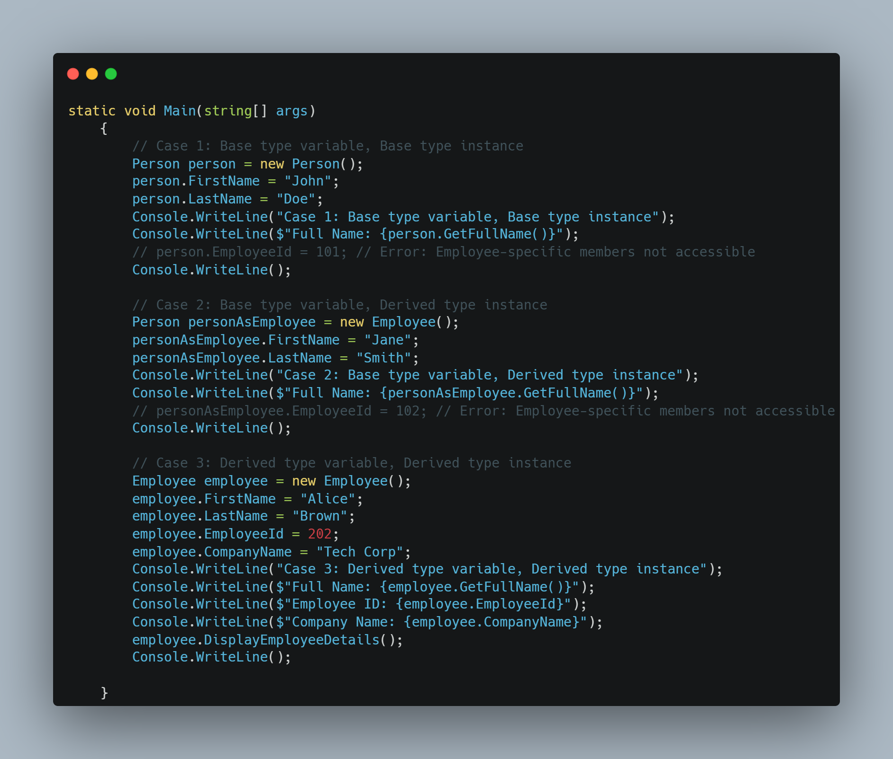
Inheritance
Achieved
www.bacancytechnology.com

Slide 59
Inheritance
Achieved
Achieved
Important Points:
A class can inherit a single class only. It cannot inherit from multiple classes.
A class cannot inherit from a struct.
A class can inherit (implement) one or more interfaces.
A Struct can inherit from one or more interfaces. However, it cannot inherit from another struct or class.
An interface can inherit from one or more interfaces but cannot inherit from a class or a struct.
Constructors or destructors cannot be inherited.
www.bacancytechnology.com

Slide 60
Polymorphism
Achieved
Achieved
Polymorphism is a Greek word that means multiple forms or shapes. You can use polymorphism if you want to have multiple forms of one or more methods of a class with the same name.
In C#, polymorphism can be achieved in two ways:
Compile-time Polymorphism
Run-time Polymorphism
Compile-time Polymorphism (Method Overloading):
Compile-time polymorphism is also known as method overloading. C# allows us to define more than one method with the same name but with different signatures. This is called method overloading.
Method overloading is also known as early binding or static binding because which method to call is decided at compile time, early than the runtime.
Rules for Method Overloading:
Method names should be the same but method signatures must be different. Either the number of parameters, type of parameters, or order of parameters must be different.
The return type of the methods does not play any role in the method overloading.
Optional Parameters take precedence over implicit type conversion when deciding which method definition to bind.
www.bacancytechnology.com

Slide 61
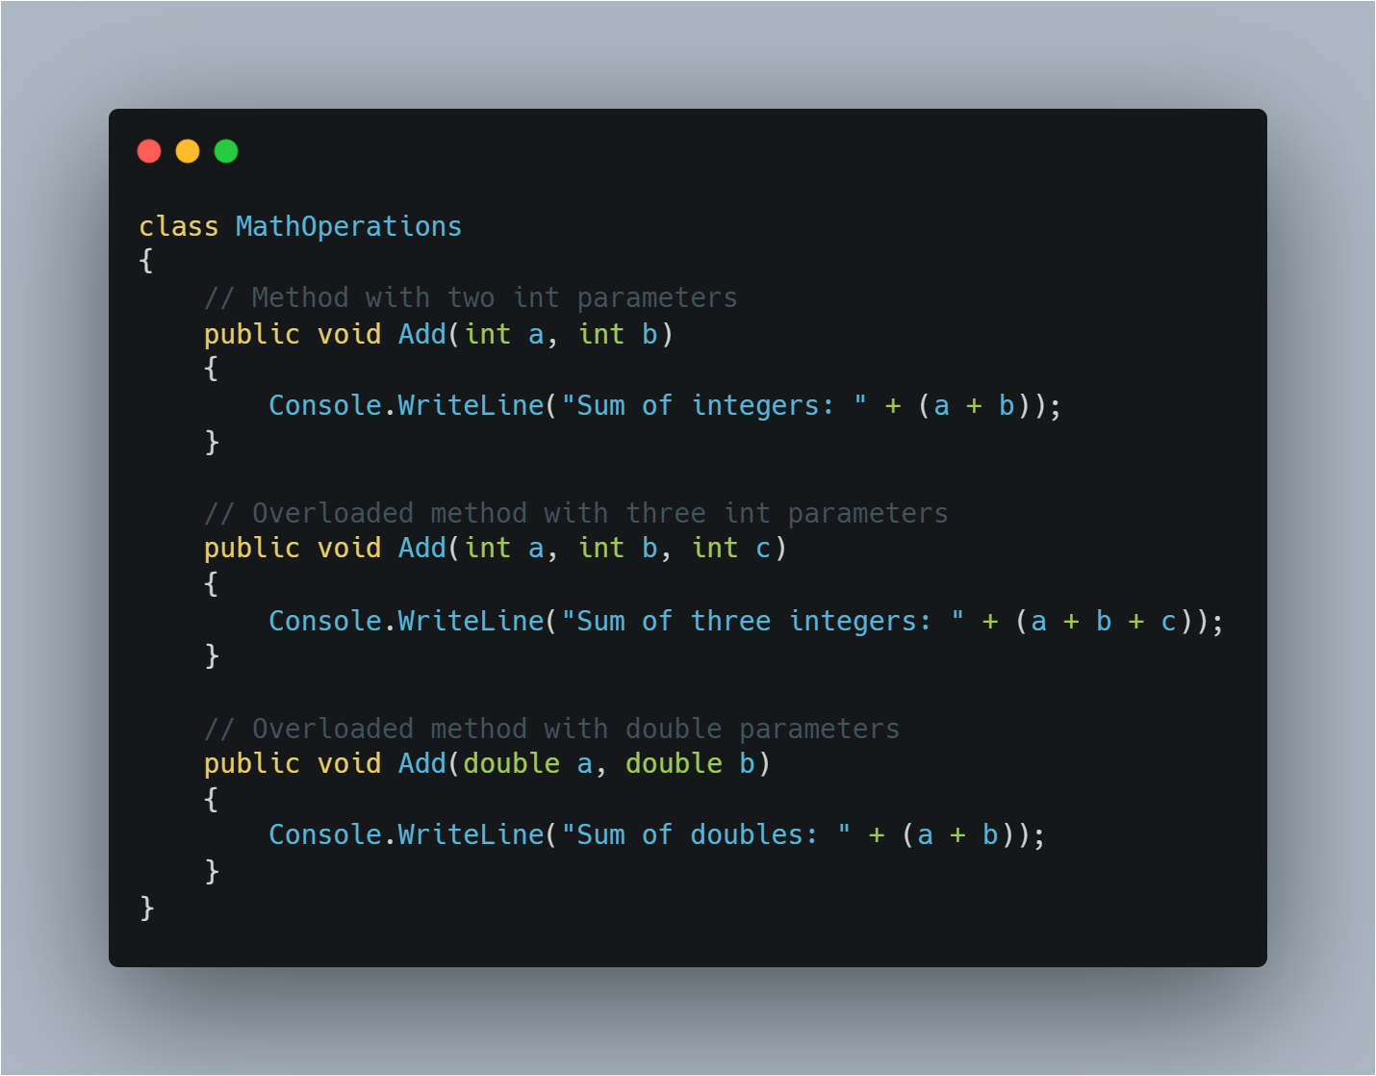
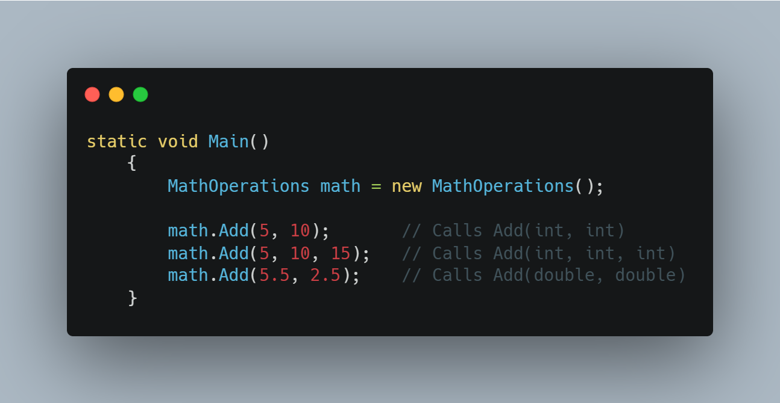
Method Overloading
Achieved
www.bacancytechnology.com

Slide 62
Method Overriding
Achieved
Run-time polymorphism is also known as inheritance-based polymorphism or method overriding.
Inheritance allows you to inherit a base class into a derived class and all the public members of the base class automatically become members of the derived class. However, you can redefine the base class's member in the derived class to provide a different implementation than the base class. This is called method overriding that also known as runtime polymorphism.
In C#, by default, all the members of a class are sealed and cannot be redefined in the derived class. Use the virtual keyword with a member of the base class to make it overridable, and use the override keyword in the derived class to indicate that this member of the base class is being redefined in the derived class
www.bacancytechnology.com

Slide 63
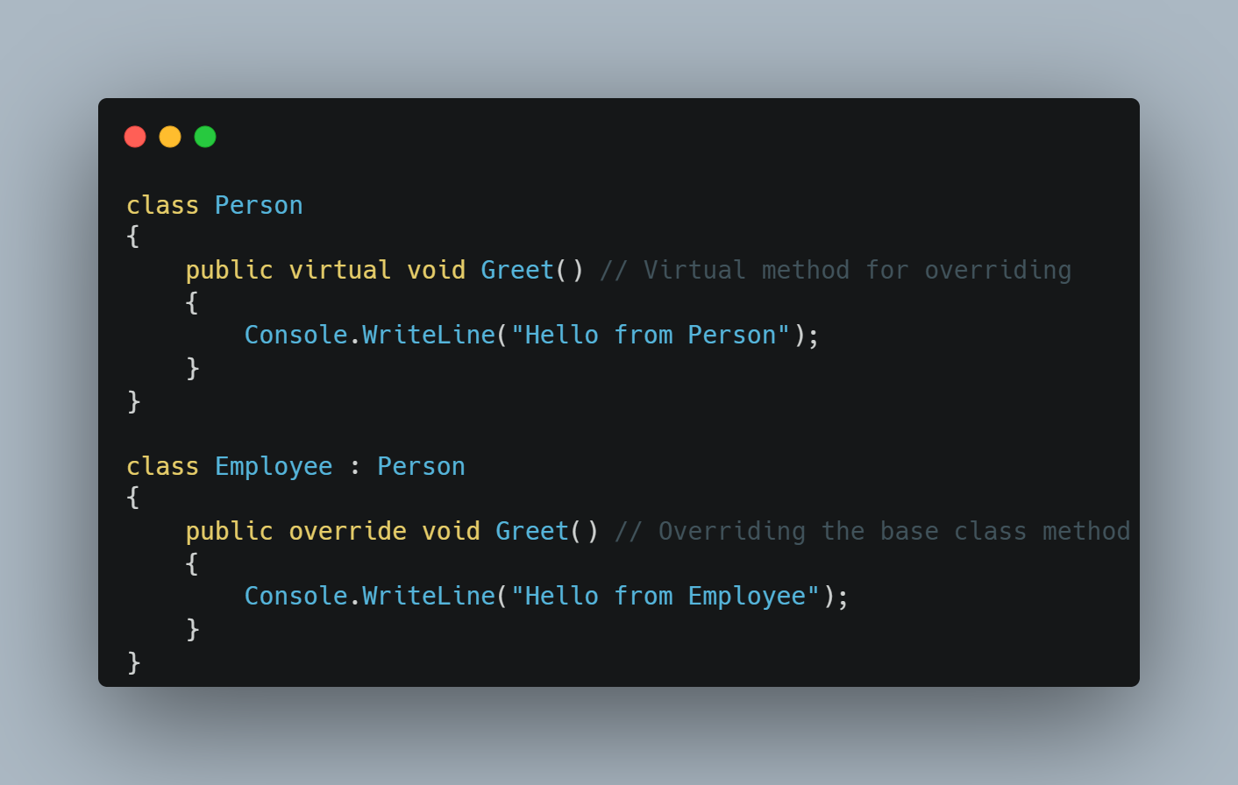
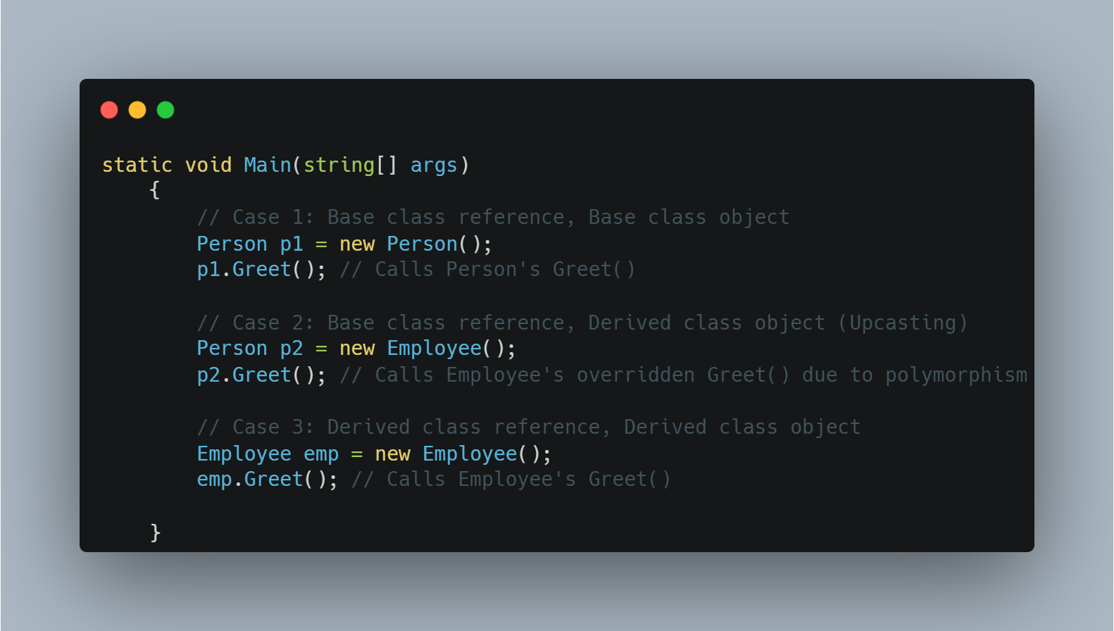
Method Overriding
Achieved
www.bacancytechnology.com

Slide 64
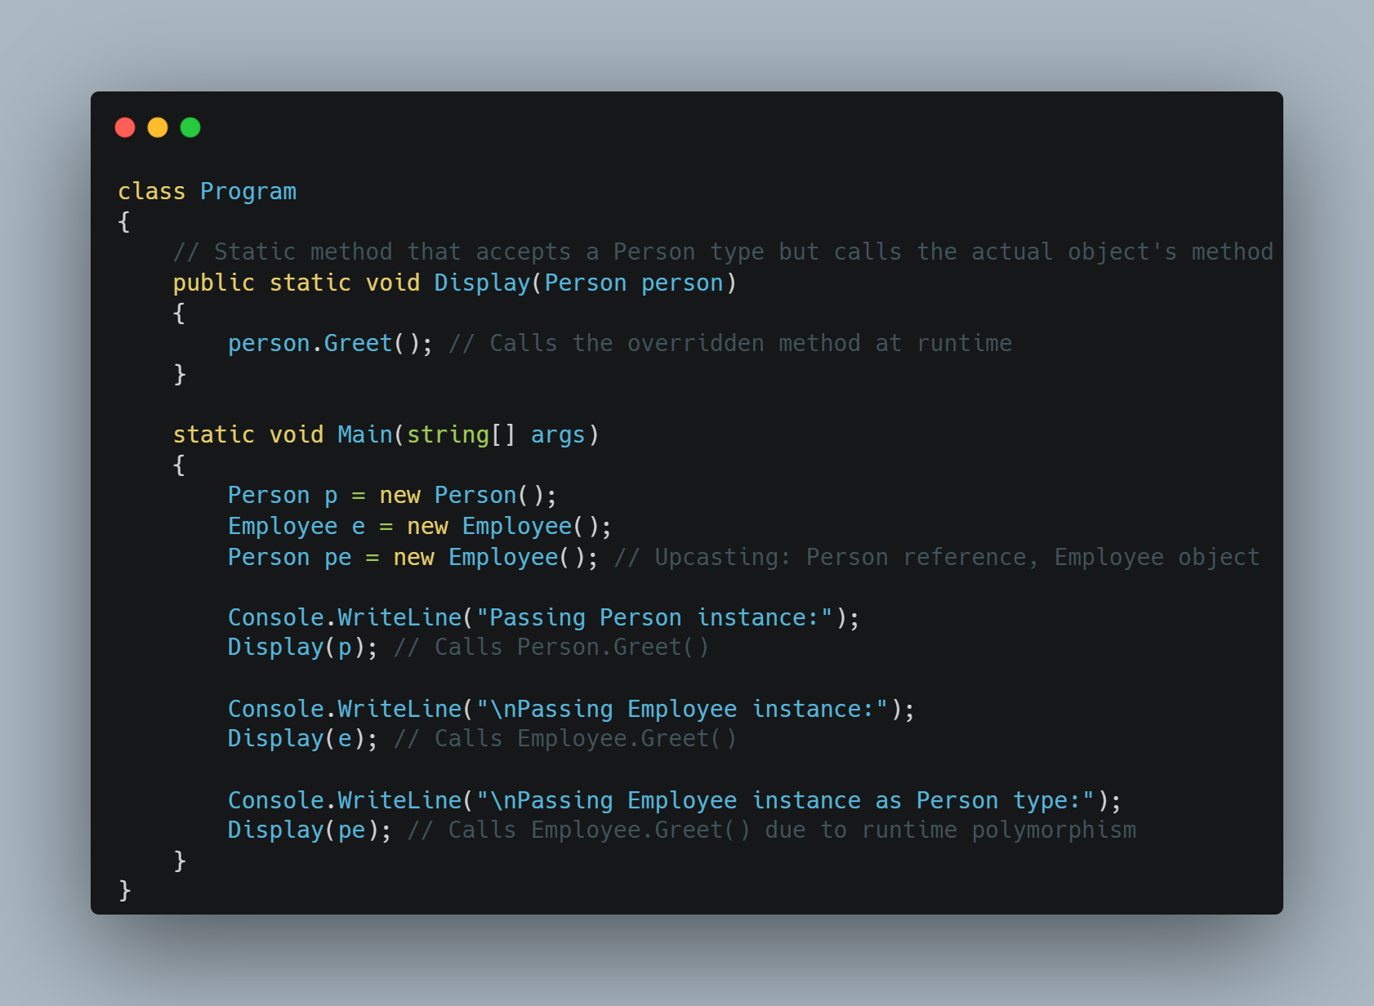
Method Overriding
Achieved
As you learned in the previous chapter the C# compiler decides which methods to call at the compile time in the compile-time polymorphism. In the run time polymorphism, it will be decided at run time depending upon the type of an object.
To understand why method overriding is called the runtime polymorphism, look at the given example.
In the above example, the Display() method takes a parameter of the Person type. Thus, you can pass an object of the Person type or the Employee type when you call the Display() method. The Display() method does not know the type of parameter you passed at compile time. It can be anything at runtime. That's why method overriding is called runtime polymorphism.
www.bacancytechnology.com

Slide 65
Runtime Polymorphism (Method Overriding)
Achieved
Achieved
Rules for Overriding:
A method, property, indexer, or event can be overridden in the derived class.
Static methods cannot be overridden.
Must use virtual keyword in the base class methods to indicate that the methods can be overridden.
Must use the override keyword in the derived class to override the base class method.
www.bacancytechnology.com

Slide 66
Virtual Methods
Achieved
In C#, a virtual method is a method that can be overridden in a derived class.
When a method is declared as virtual in a base class, it allows a derived class to provide its own implementation of the method.
To declare a method as virtual in C#, the "virtual" keyword is used in the method declaration in the base class.
In the derived class, the method can be overridden by using the "override" keyword in the method declaration. For example.
Using virtual methods can be useful in situations where you want to provide a base implementation in a base class, but allow derived classes to modify or extend the behavior of that method.
We can't use the virtual modifier with the static, abstract, private, or override modifiers.
www.bacancytechnology.com

Slide 67
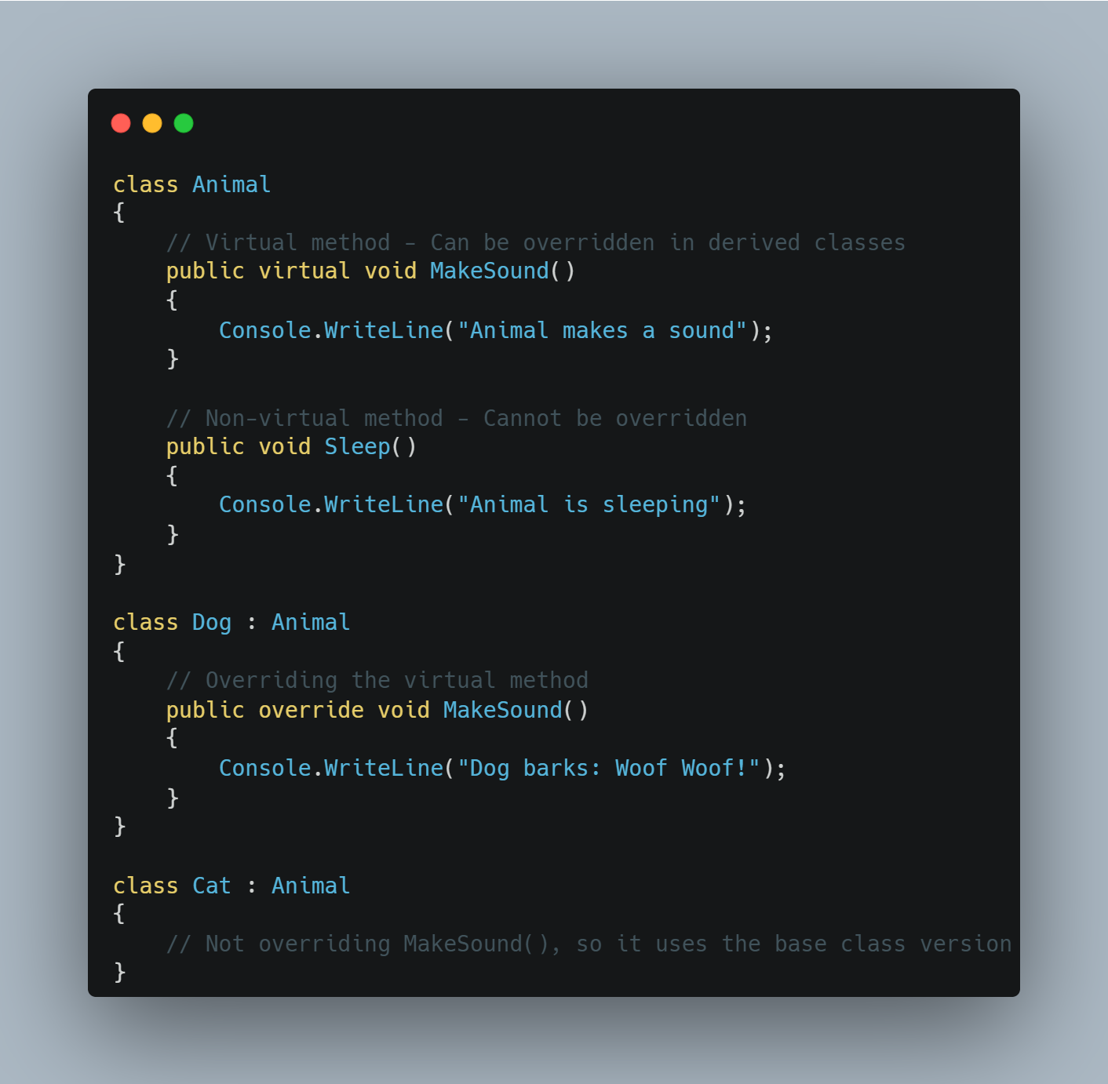
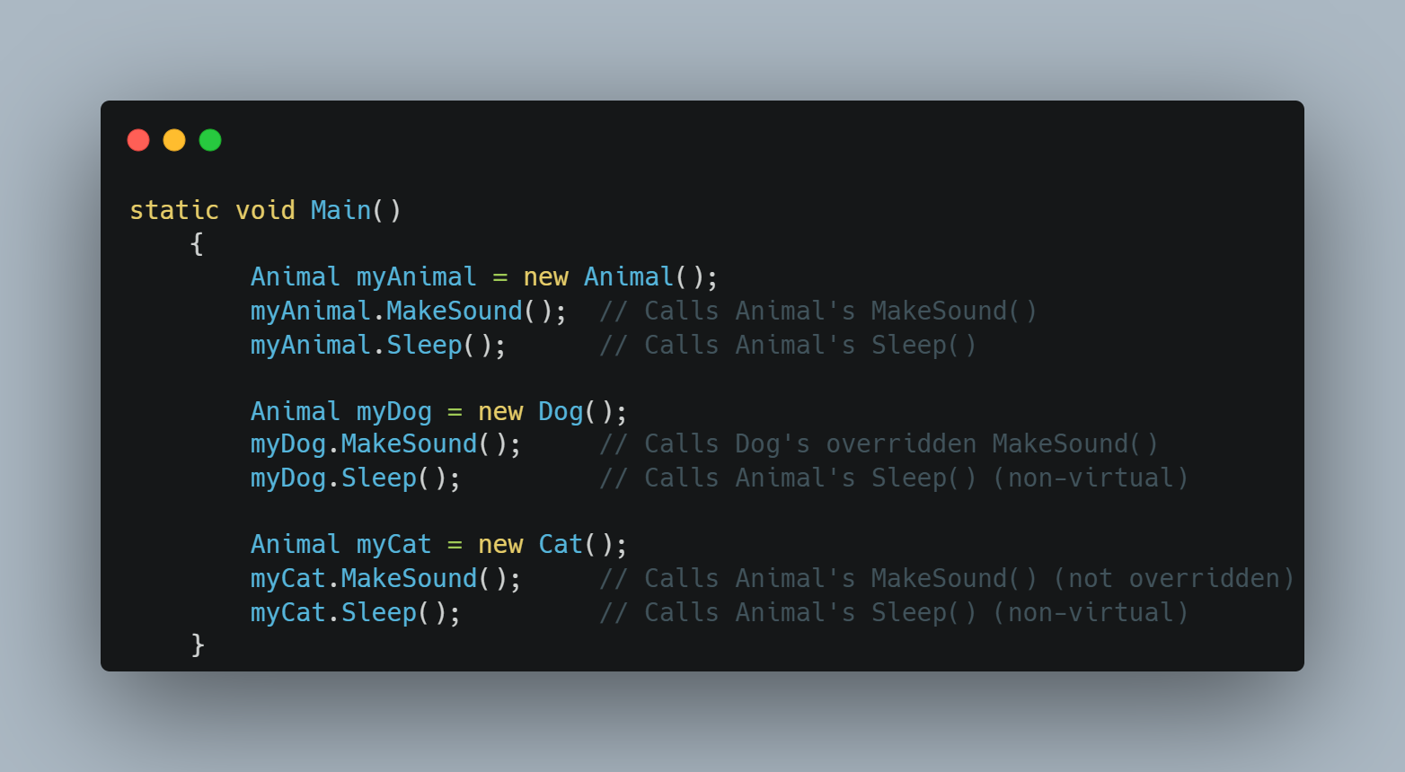
Virtual Methods
Achieved
www.bacancytechnology.com

Slide 68
Abstract class and methods
Achieved
An abstract class is a class that cannot be instantiated. It is designed to be a base class and must be inherited by other classes. It can have abstract methods (without implementation) and concrete methods (with implementation).
Abstract classes and methods are declared using the abstract keyword.
Abstract classes cannot be instantiated directly, but they can be used as base classes for other classes that derive from them.
A method without the body is known as the Abstract Method. What the method contains is only the declaration of the method.
Who will Provide the Implementation of Abstract Methods? Answer is child class
An abstract class can contain both abstract and non-abstract methods. If a child class of an abstract class wants to consume any non-abstract methods of its parent, it should implement all abstract methods.
www.bacancytechnology.com

Slide 69
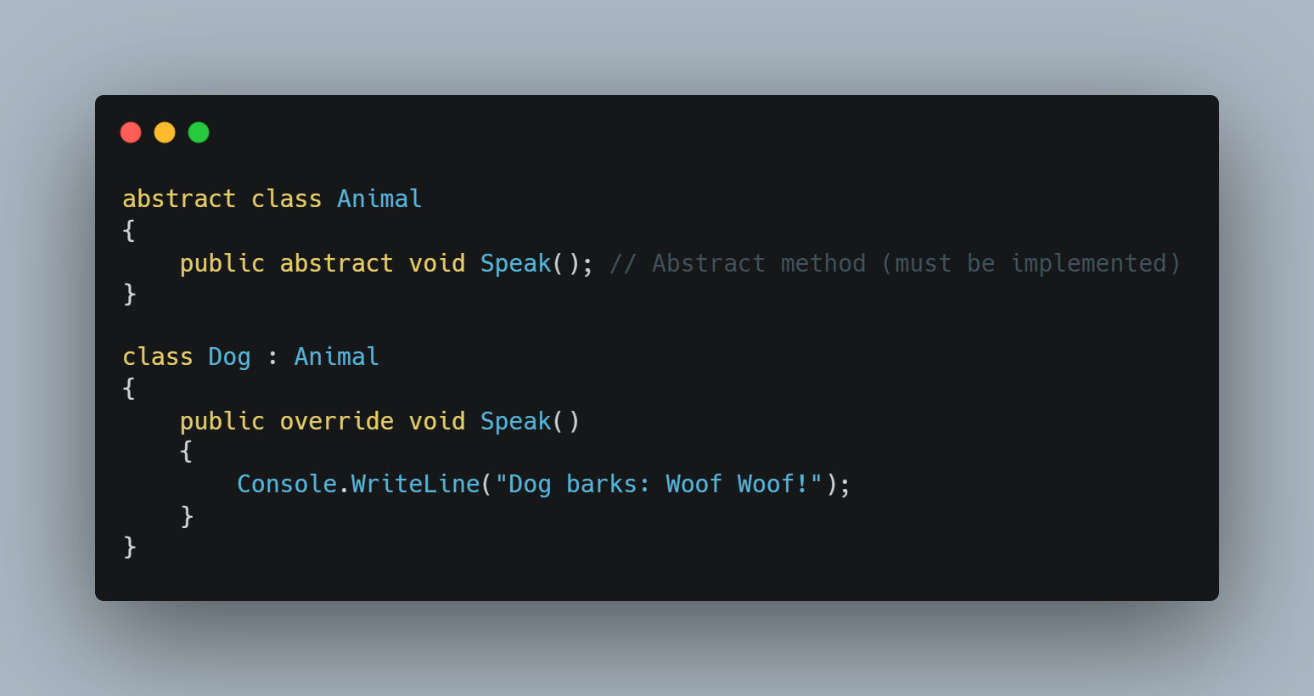
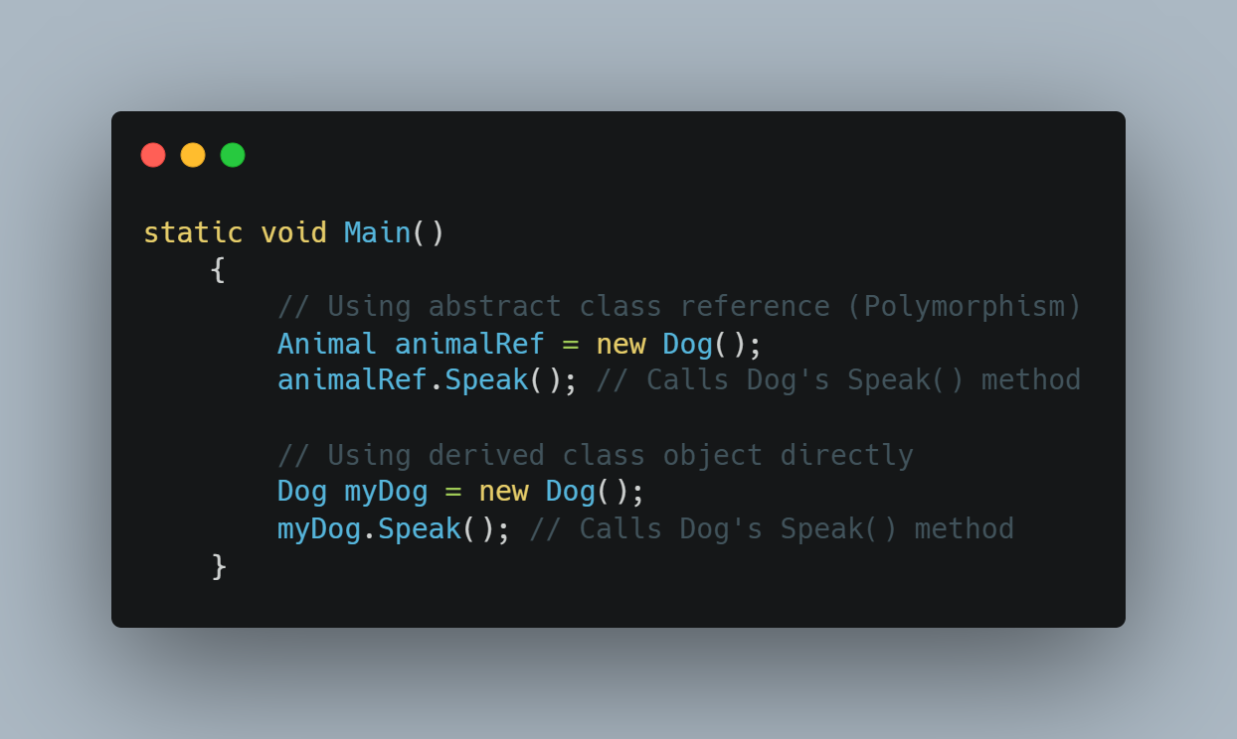
Abstract class and methods
Achieved
www.bacancytechnology.com

Slide 70
Interface
Achieved
The Interface in C# is a Fully Unimplemented Class used for declaring a set of operations/methods of an object.
An interface is a contract that defines what a class should do, but not how it does it. It only contains method declarations (without implementation), and any class that implements the interface must provide implementations for all its methods.
By default, every member of an interface is abstract, so we aren’t required to use the abstract modifier on it again, just like we do in the case of an abstract class.
We cannot declare fields/variables, constructors, and destructors in an interface in C#.
C# does not support multiple inheritance for classes (a class cannot inherit from multiple classes) but supports multiple interface implementation. If you need a class to inherit behavior or structure from multiple sources, you can use interfaces to achieve this. This allows you to share code among different classes without the complexities of multiple-class inheritance.
www.bacancytechnology.com

Slide 71
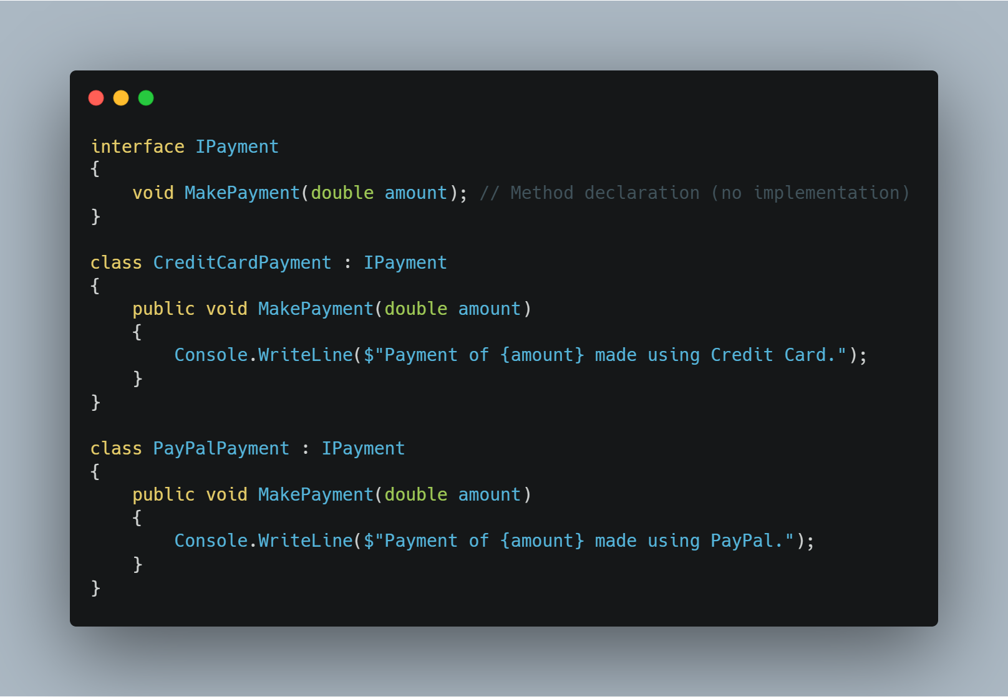
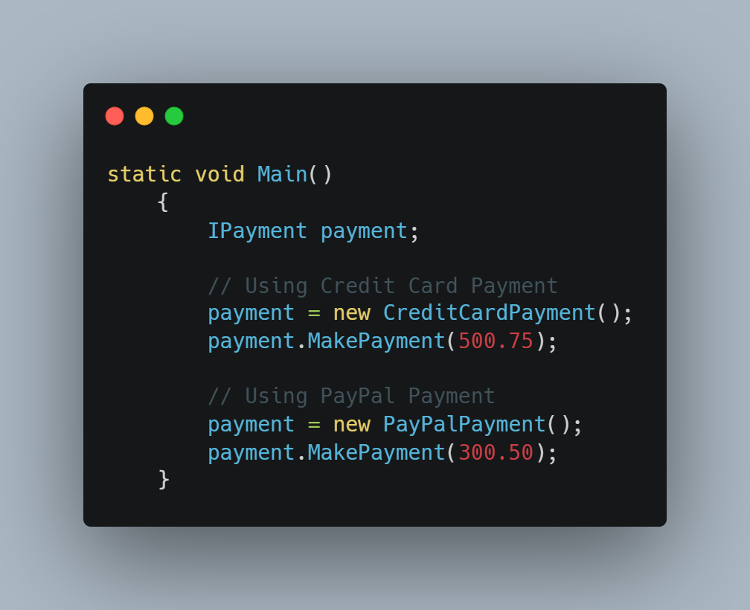
Interface
Achieved
www.bacancytechnology.com

Slide 72
Difference between Abstract Class and Interface
Achieved
Abstract Class | Interface
It contains both declaration and implementation parts. | It contains only the declaration of methods, properties, events or indexes. Since C# 8, default implementations can also be included in interfaces
Multiple inheritance is not achieved by abstract class. | Multiple inheritance is achieved by interface.
It contain constructor. | It does not contain constructor.
It can contain static members. | It does not contain static members.
It can contain different types of access modifiers like public, private, protected etc. | It only contains public access modifier because everything in the interface is public.
The performance of an abstract class is fast. | The performance of interface is slow because it requires time to search actual method in the corresponding class.
www.bacancytechnology.com

Slide 73
Difference between Abstract Class and Interface
Achieved
Abstract Class | Interface
It is used to implement the core identity of class. | It is used to implement peripheral abilities of class.
A class can only use one abstract class. | A class can use multiple interface.
If many implementations are of the same kind and use common behavior, then it is superior to use abstract class. | If many implementations only share methods, then it is superior to use Interface.
Abstract class can contain methods, fields, constants, etc. | Interface can only contains methods, properties, indexers, events.
The keyword “:” can be used for implementing the Abstract class. | The keyword “:” and “,” can be used for implementing the Interface.
It can be fully, partially or not implemented. | It should be fully implemented.
www.bacancytechnology.com

Slide 74
Advanced Inheritance & Polymorphism
Achieved
New Keyword : The new keyword is used to indicate that a method or property in a derived class is intended to hide, rather than override, a method or property in the base class.
It's important to note that the new keyword can be used to hide any method or property, regardless of whether it's virtual or not.
The base class method can still be accessed using a base class reference.
Usage:
When you don’t want to override but just define a new implementation of a method in the derived class.
When both versions of the method should be accessible based on the reference type.
www.bacancytechnology.com

Slide 75
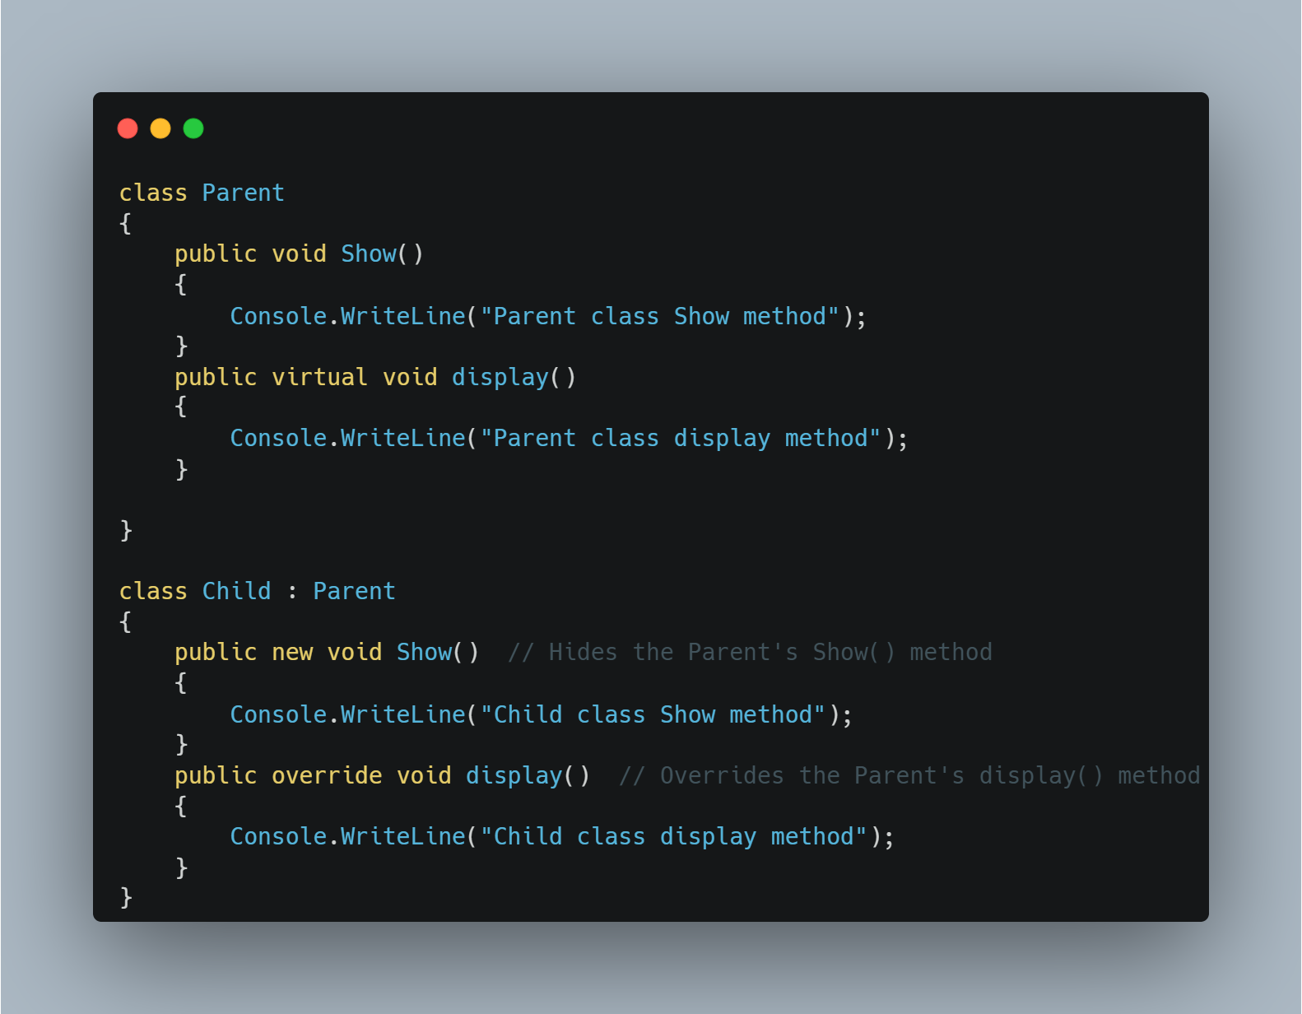
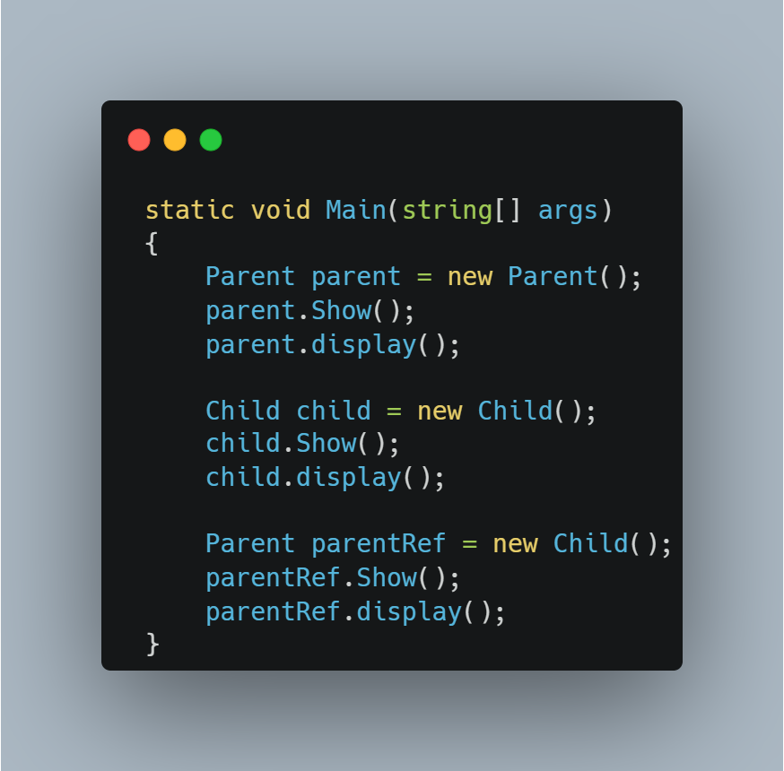
Advanced Inheritance & Polymorphism
Achieved
www.bacancytechnology.com

Slide 76
Difference between Method Overriding and Method Hiding
Achieved
Method Overriding | Method Hiding (new keyword)
Runtime binding (based on object type) | Compile-time binding (based on reference type)
Derived class method is called even with base class reference (polymorphism) | Base class method is called when using base class reference
If many implementations are of the same kind and use common behavior, then it is superior to use abstract class. | If many implementations only share methods, then it is superior to use Interface.
Used when a derived class wants to modify base class behavior dynamically | Used when a derived class wants to define a completely new independent method
When the parent class reference variable points to the child class, then the method in the child class is invoked while calling. | When the parent class reference variable points to the child class, then the hidden method in the parent class is invoked while calling.
www.bacancytechnology.com

Slide 77
SOLID Principles
Achieved
SOLID is a set of five principles in object-oriented programming (OOP) that help developers write clean, scalable, and maintainable code.
SOLID Design Principles represent five Design Principles used to make software designs more understandable, flexible, and maintainable. The Five SOLID Design Principles are as follows: 1. SRP – Single Responsibility Principle 2. OSP – Open – Closed Principle 3. LSP – Liskov Substitution Principle 4. ISP – Interface Segregation Principle 5. DIP – Dependency Inversion Principle
Applying the SOLID principles in our Application Development can make our application code more modular, easier to understand, and less error-prone when changes are made.
www.bacancytechnology.com

Slide 78
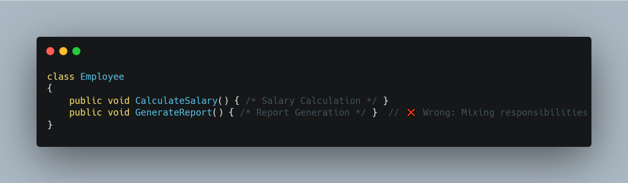
Single Responsibility Principle
Achieved
The SRP states that a class should have only one reason to change, meaning it should have only one responsibility. This promotes modularization and makes the code easier to understand and maintain.
Problem: The class is responsible for both salary calculation and report generation, which are unrelated.
www.bacancytechnology.com

Slide 79
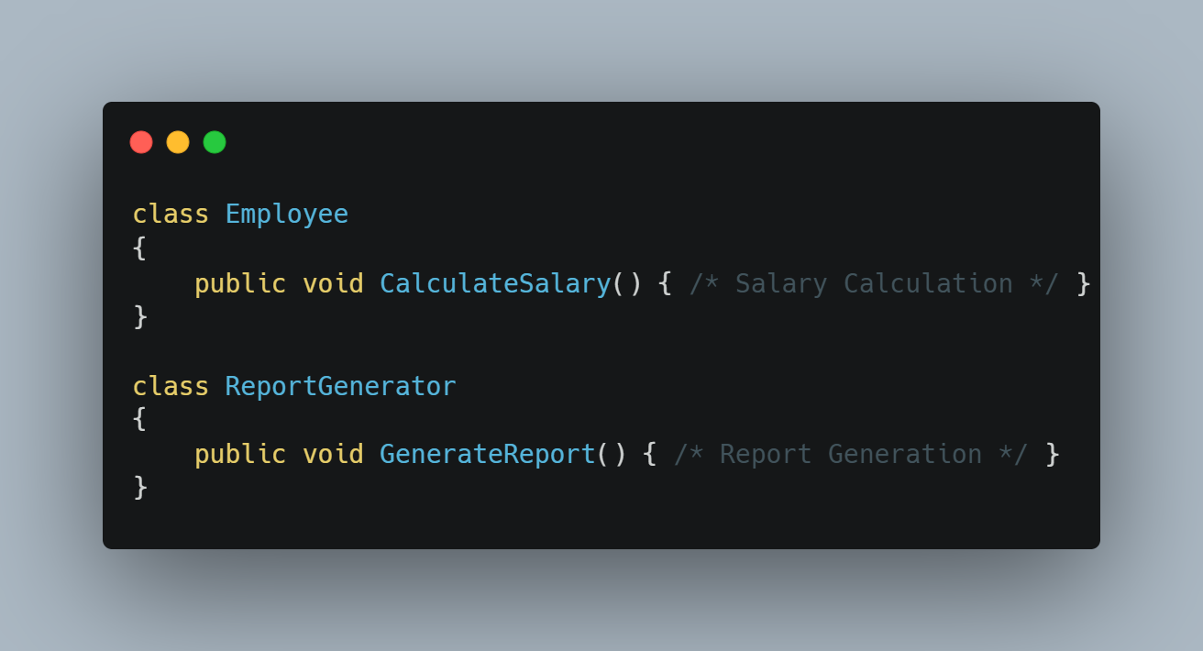
Single Responsibility Principle
Achieved
Employee handle salaries and ReportGenerator handles reports (Sepeartion of concerns).
www.bacancytechnology.com

Slide 80
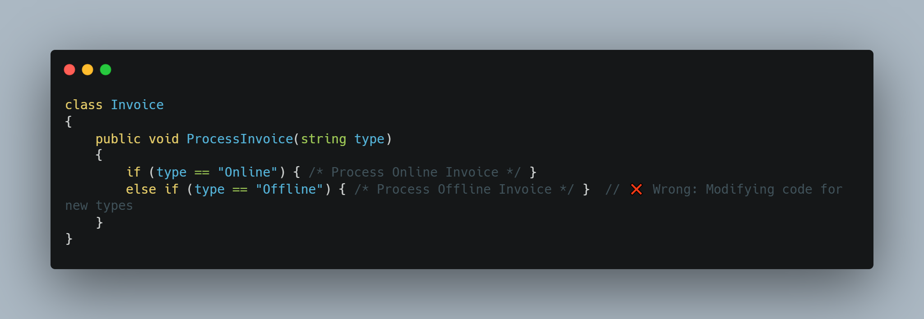
Open-Closed Principle
Achieved
Software entities (classes, modules, functions) should be open for extension but closed for modification.
Once a class is written, it should be closed for modifications but open for extensions.
Problem: Every time a new invoice type is added, we need to modify the class, which breaks OCP.
www.bacancytechnology.com

Slide 81
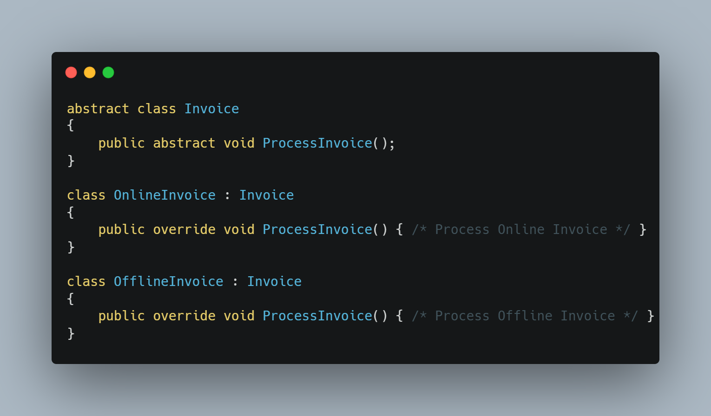
Open-Closed Principle
Achieved
New invoice types can be added without modifying existing code, only by extending the base class.
www.bacancytechnology.com

Slide 82
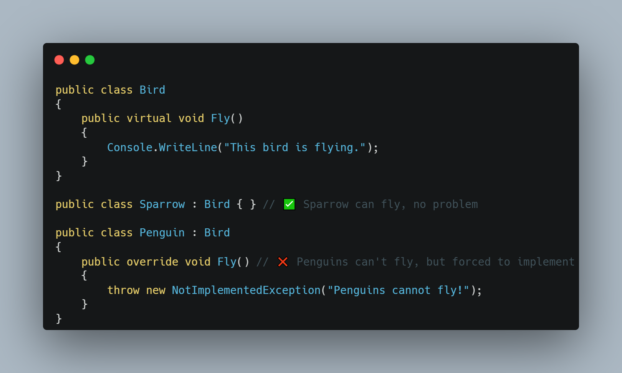
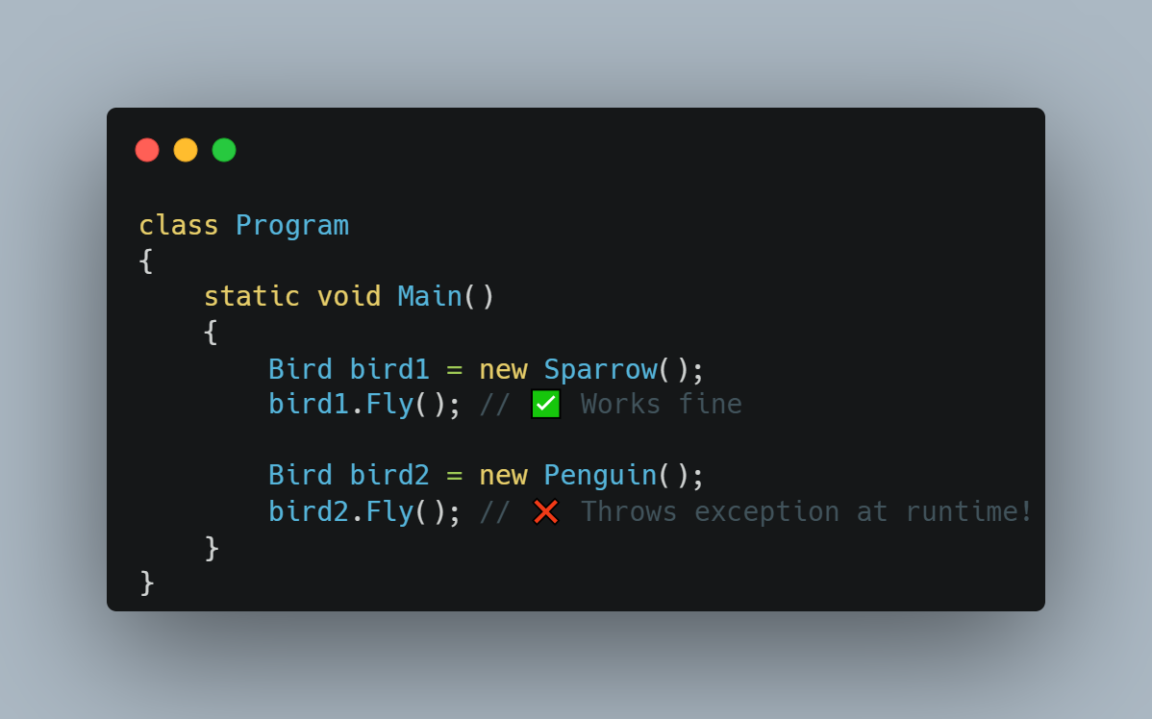
Liskov Substitution Principle
Achieved
Derived classes should be replaceable for their base classes without affecting correctness.
A subclass should be able to replace its superclass without causing errors.
www.bacancytechnology.com

Slide 83
Liskov Substitution Principle
Achieved
Problem :
Penguin inherits from Bird but cannot fly, so Fly() throws an exception.
This violates LSP because a Penguin cannot fully substitute a Bird without breaking behavior.
Solution :
Instead of forcing all birds to have a Fly() method, we should create separate interfaces for Flying Birds and Non-Flying Birds.
www.bacancytechnology.com

Slide 84
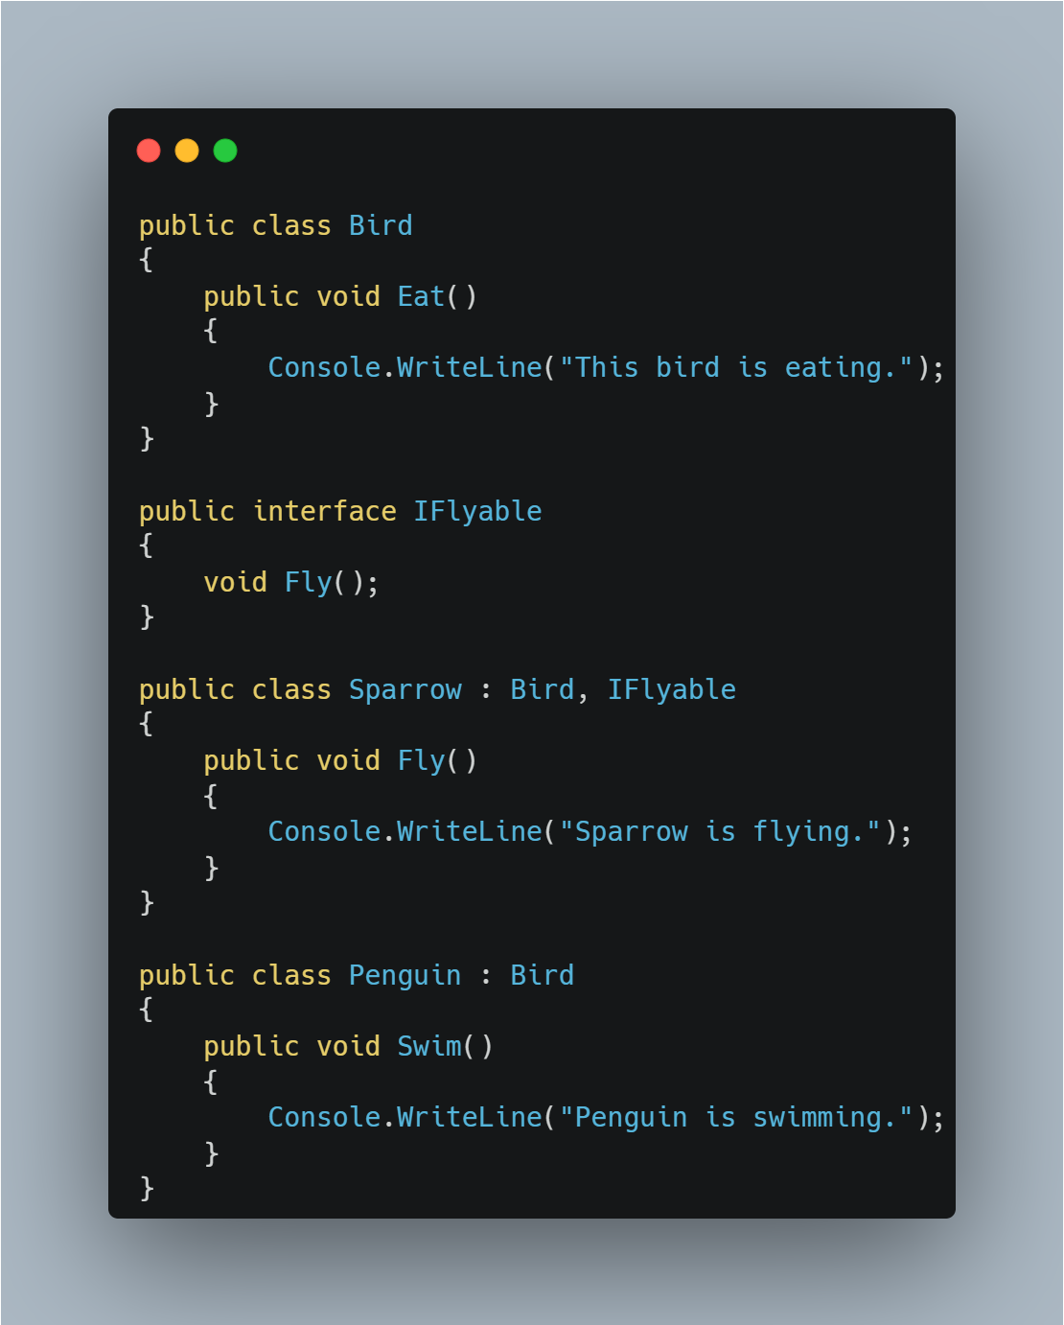
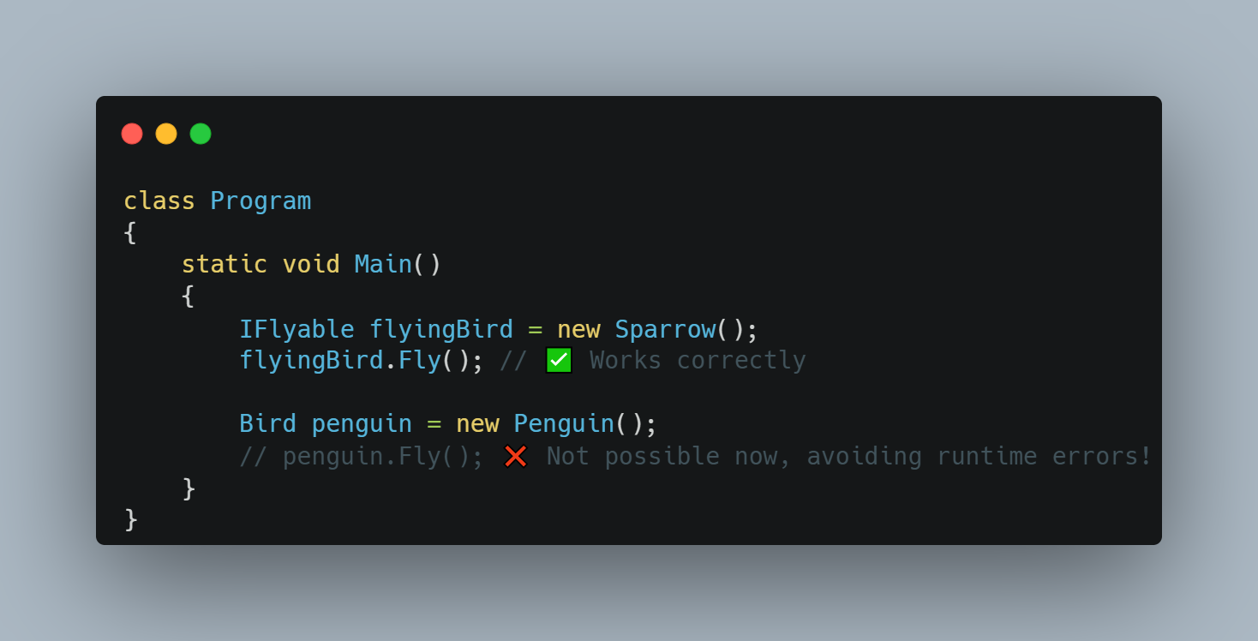
Liskov Substitution Principle
Achieved
www.bacancytechnology.com

Slide 85
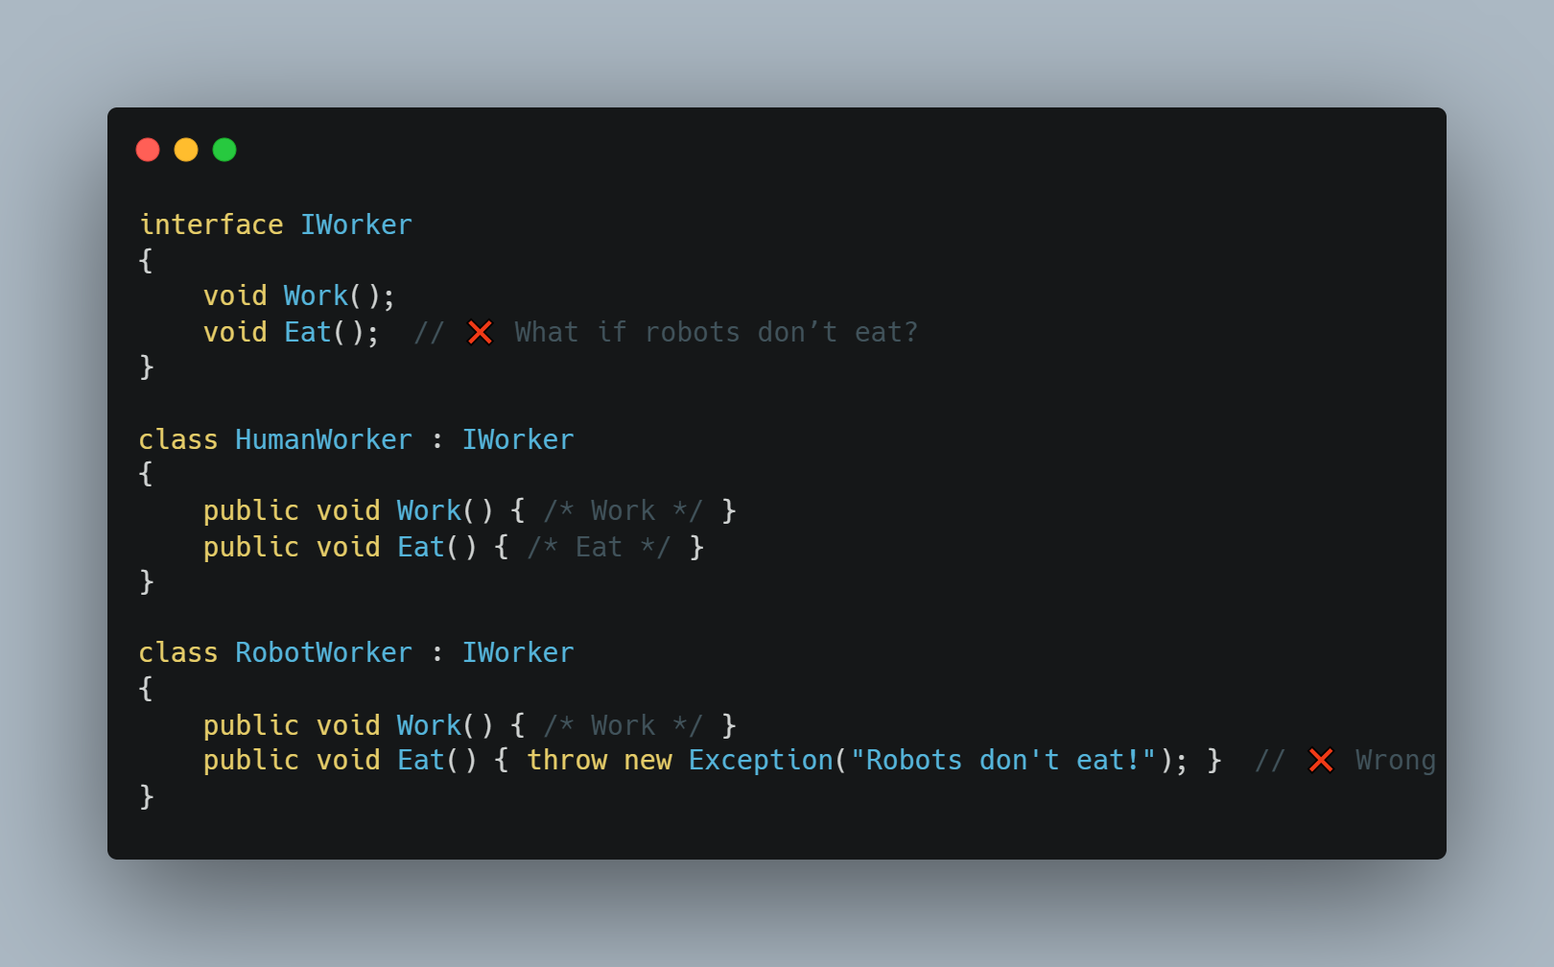
Interface Segregation Principle
Achieved
The Interface Segregation Principle states that a class should not be forced to implement interfaces it does not use.
This principle encourages the creation of small, client-specific interfaces.
www.bacancytechnology.com

Slide 86
Interface Segregation Principle
Achieved
Problem :
RobotWorker is forced to implement Eat(), which does not make sense for robots.
Solution:
HumanWorker implements both IWorkable and IEatable.
RobotWorker only implements IWorkable, avoiding the unnecessary Eat() method.
www.bacancytechnology.com

Slide 87
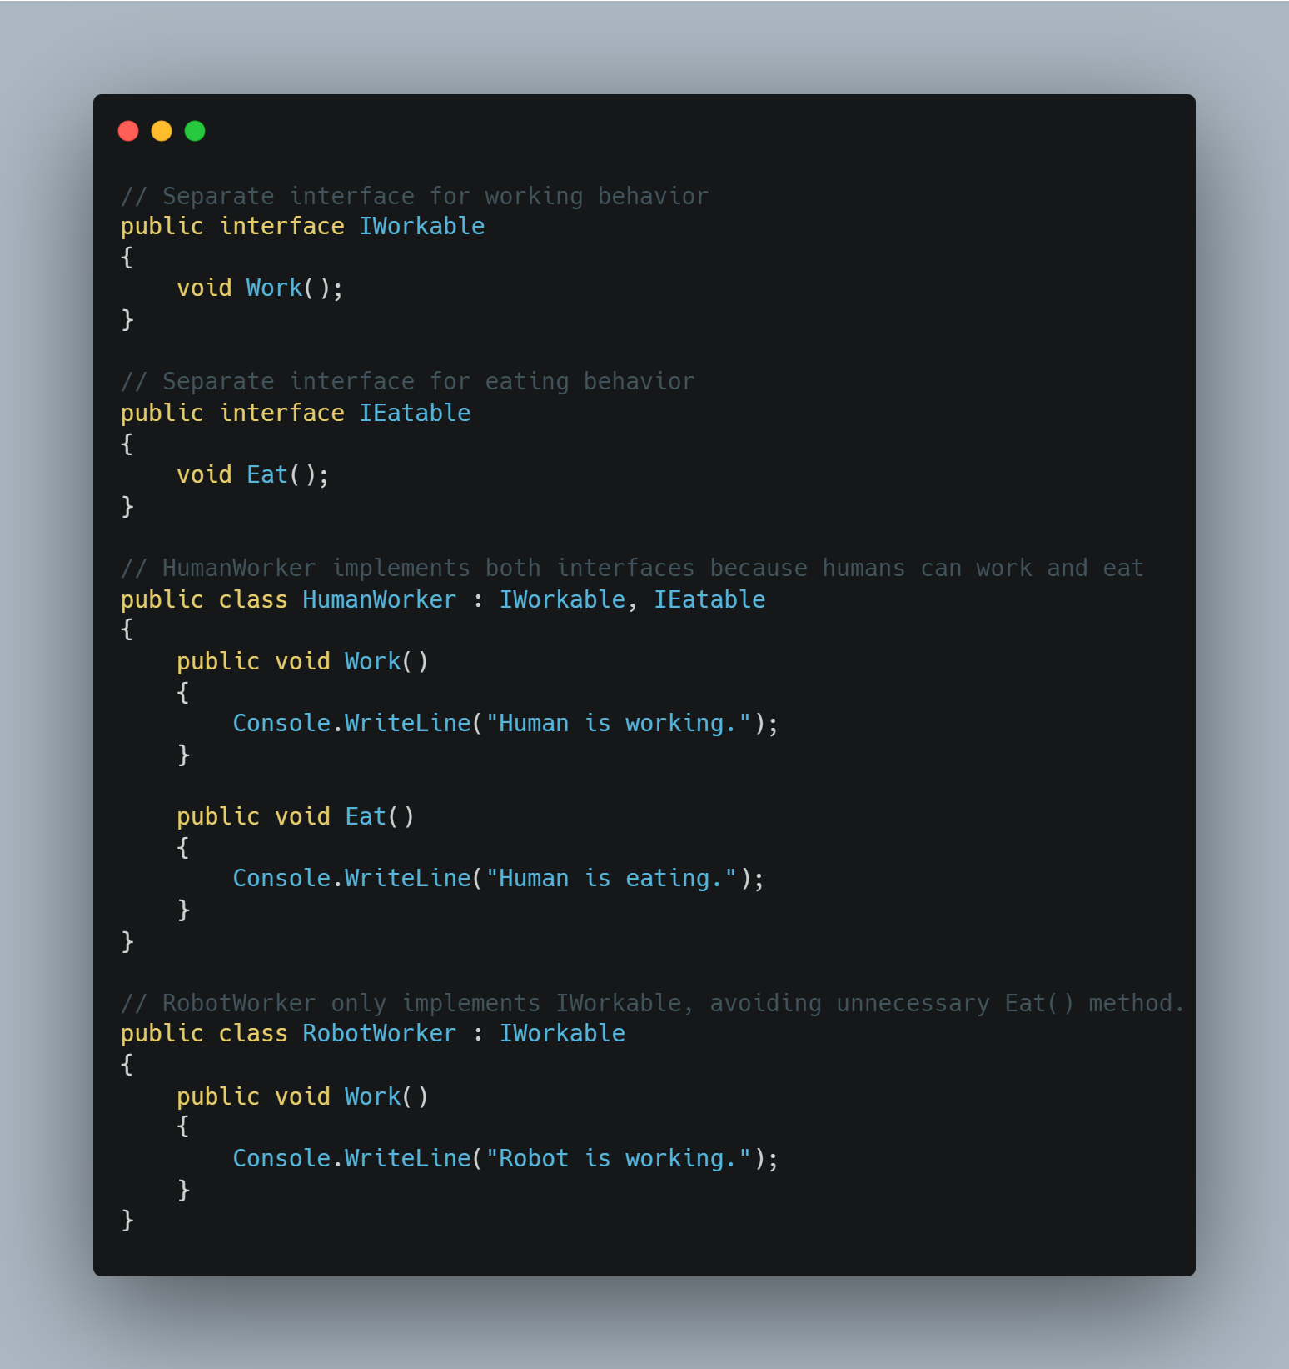
Interface Segregation Principle
Achieved
www.bacancytechnology.com

Slide 88
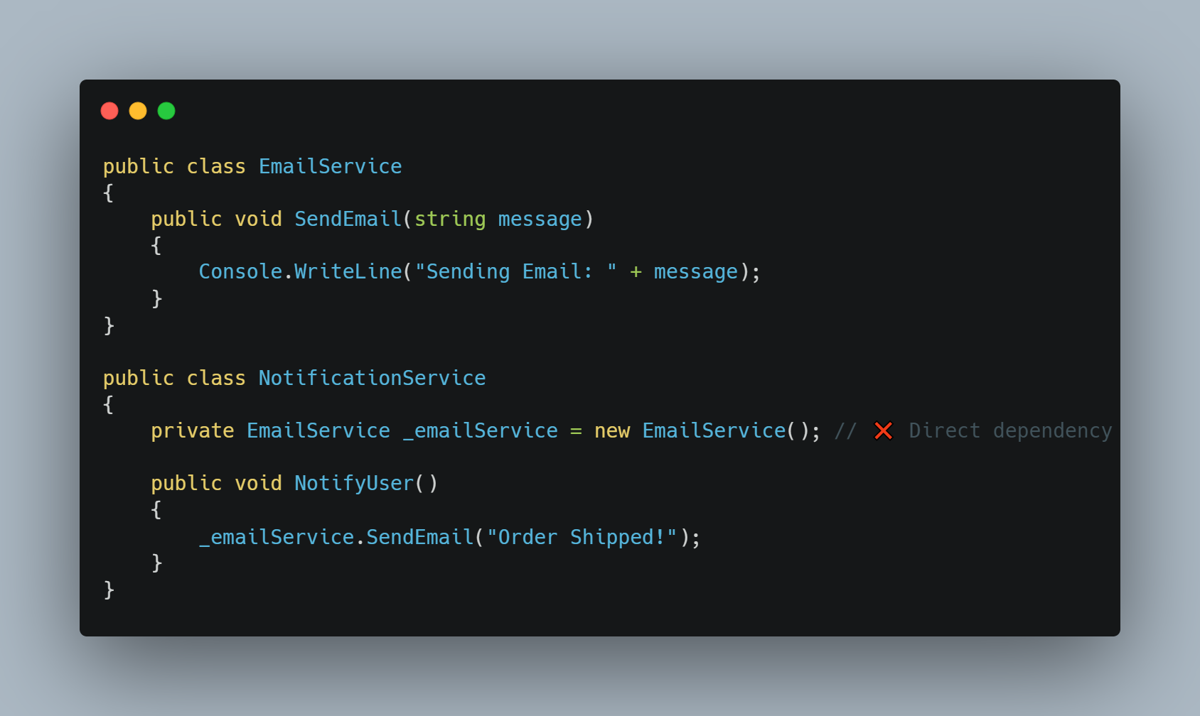
Dependency Inversion Principle
Achieved
Dependency Inversion Principle (DIP) states that High-level modules should not depend on low-level modules. Both should depend on abstractions.
Abstractions should not depend on details. Details should depend on abstractions.
www.bacancytechnology.com

Slide 89
Dependency Inversion Principle
Achieved
Problem:
NotificationService depends on EmailService directly.
If we want to switch to SMSService, we must modify NotificationService, violating Open/Closed Principle.
Solution:
Use Abstraction (Interfaces or Abstract Classes)
High-level modules should depend on this abstraction instead of concrete classes.
Apply Dependency Injection (DI)
Decouple High-Level and Low-Level Modules
www.bacancytechnology.com

Slide 90
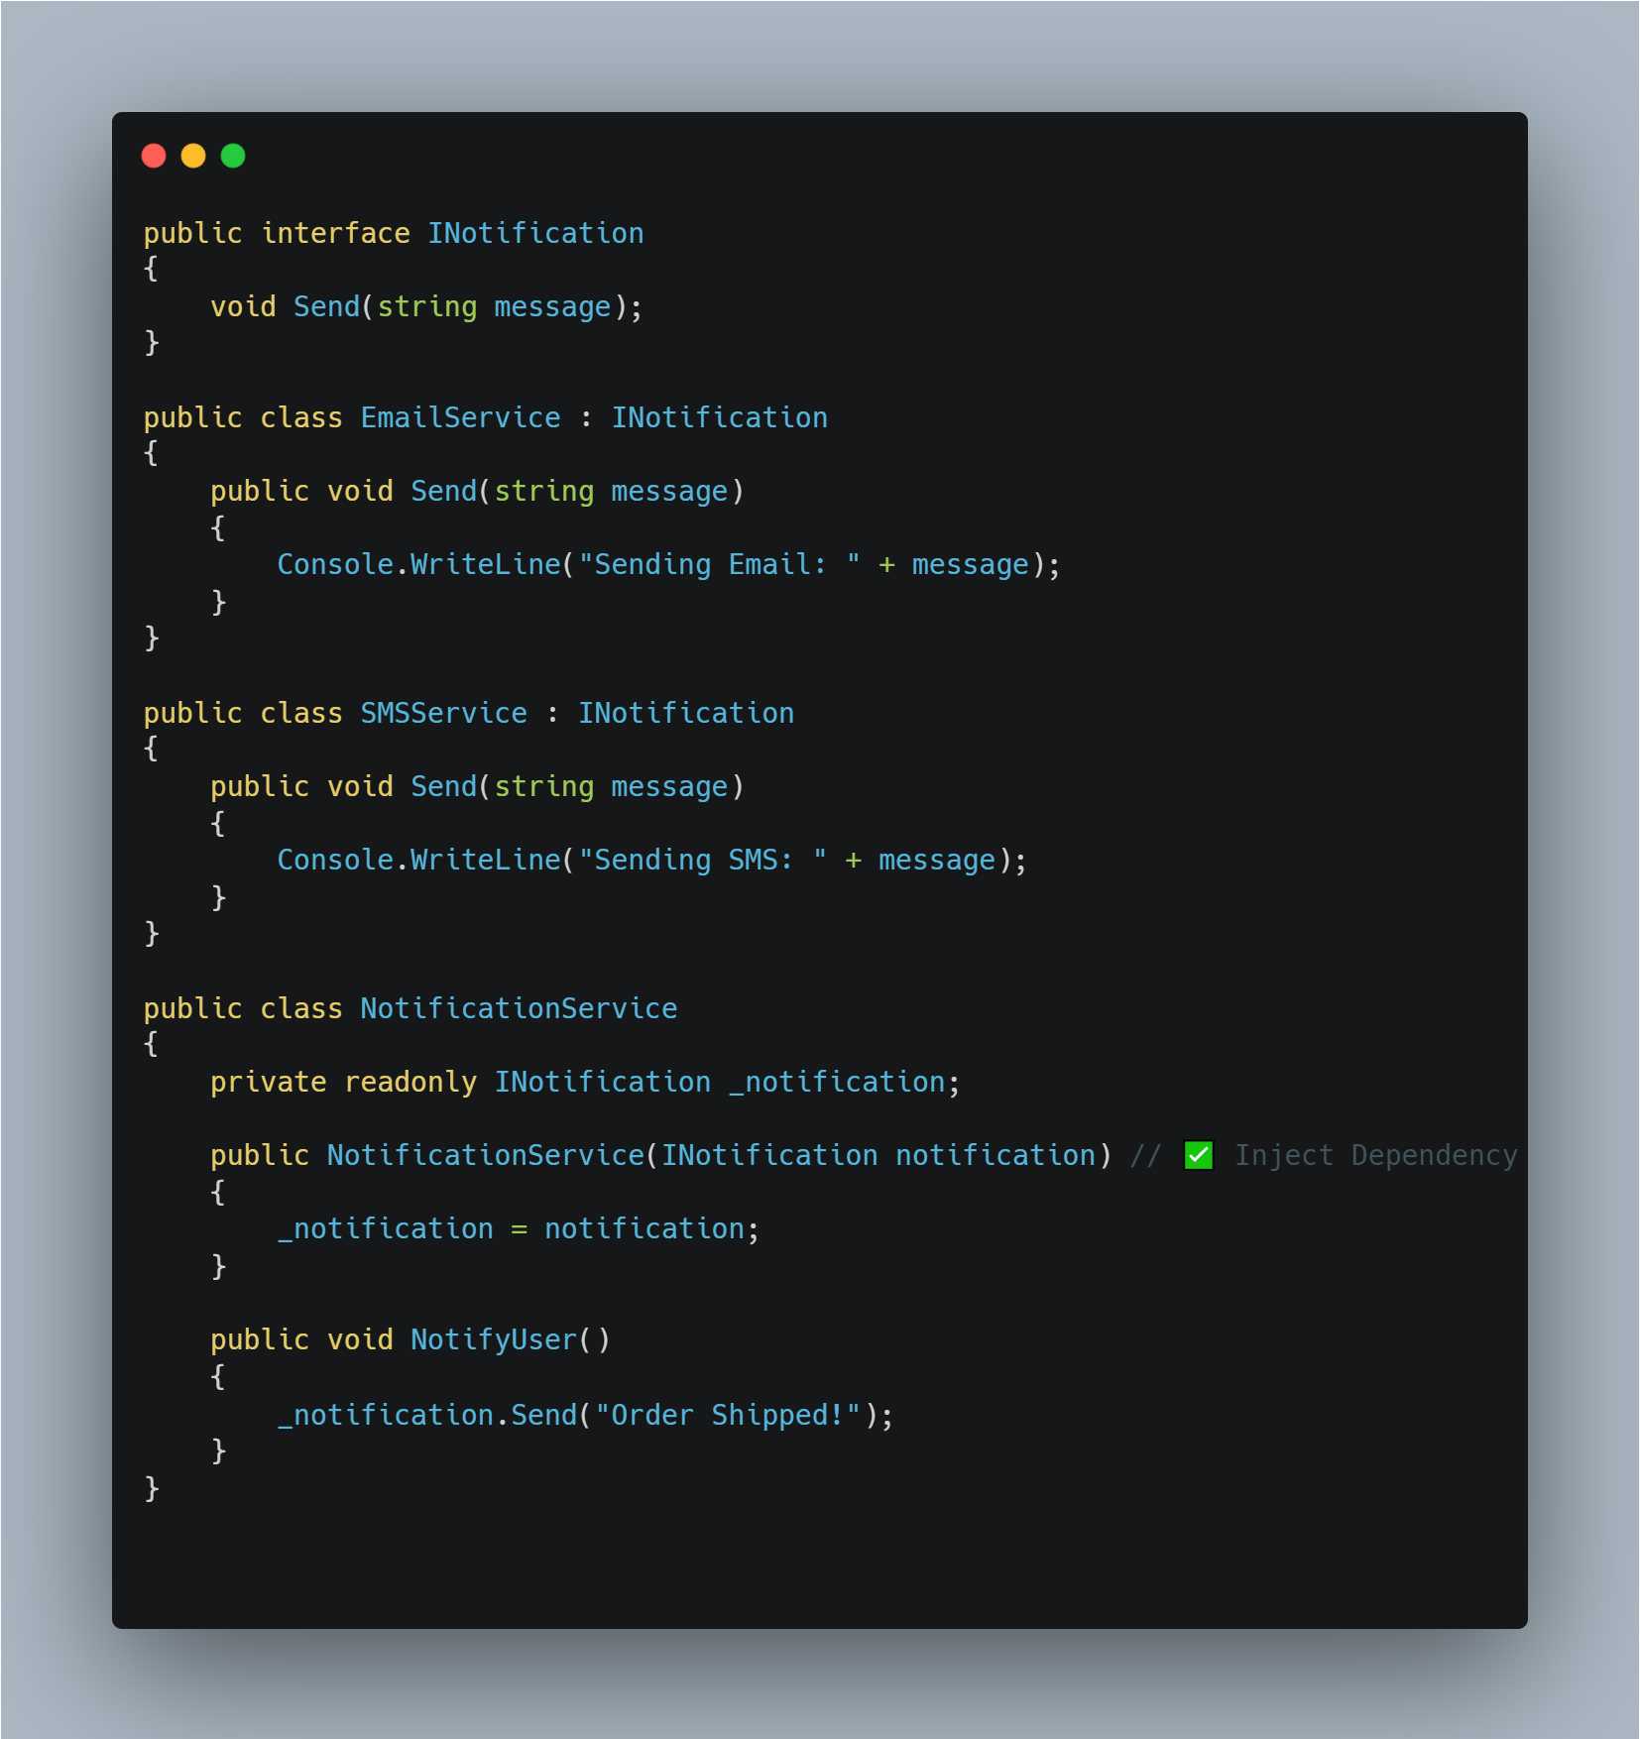
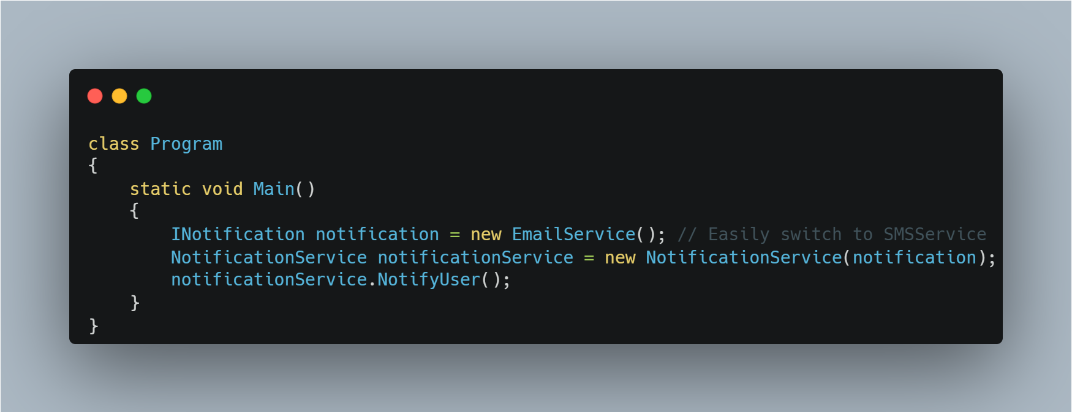
Dependency Inversion Principle
Achieved
www.bacancytechnology.com

Slide 91

Linq - Introduction
LINQ, which stands for Language Integrated Query, is a feature in programming languages like C# and VB.NET that allows developers to write queries directly within the programming language to interact with data.
LINQ provides a consistent model for querying different types of data sources, such as
databases, collections, XML, and more.
Example : Query a list of numbers in C#
www.bacancytechnology.com

Slide 92
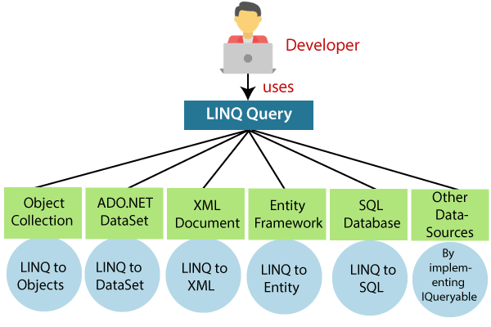
Linq - Usage
www.bacancytechnology.com

Slide 93
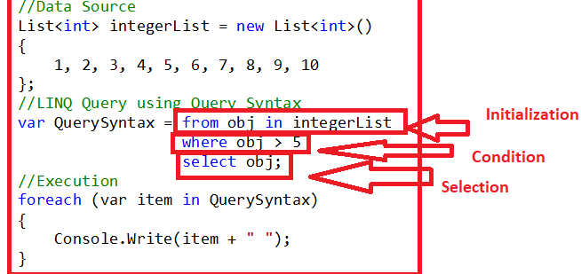
Linq - Query Syntax
Query syntax is similar to SQL.
Starts with from clause and can be end with Select or Group By clause.
www.bacancytechnology.com

Slide 94
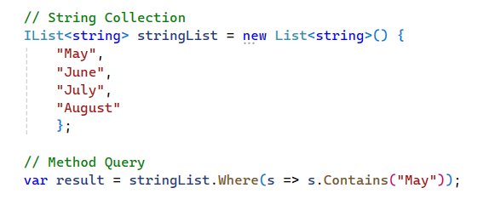
Linq - Method Syntax
Method syntax like calling an extension method already included.
It uses a lambda expression to define the condition for the Query and implicitly called using variable - var to hold result of the query.
Lambda Expression
Extension Method
www.bacancytechnology.com

Slide 95


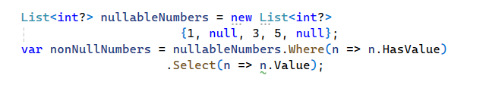
Linq - Filtering and Sorting
Filtering: Where() method filters elements.
Sorting: data with OrderBy, OrderByDescending, ThenBy, ThenByDescending
Working with nullable values in queries
www.bacancytechnology.com

Slide 96

Projection in Linq
Select: Selecting specific properties using Select():
Select Many: Flattening Collection using SelectMany()
Applied on nested collections.
Creating Anonymous Types:
www.bacancytechnology.com

Slide 97

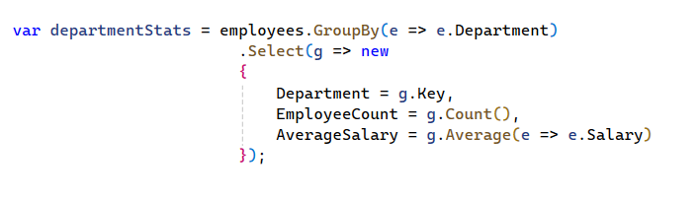
Linq - Aggregations Functions
Using aggregation methods like Count, Sum, Average, Min, Max
Grouping data with GroupBy
Selecting aggregated results in projections
www.bacancytechnology.com

Slide 98

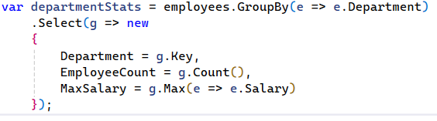
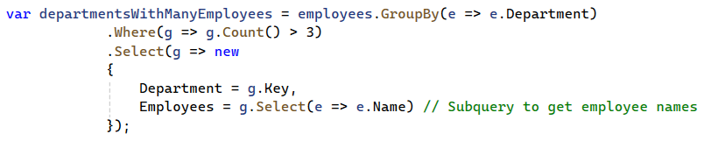
Linq - Grouping Queries
Grouping data using GroupBy and ToLookup
Aggregating grouped data with custom selectors
Creating Nested Queries and Subqueries in LINQ
www.bacancytechnology.com

Slide 99

Linq - Set Operations
Distinct: Removes duplicates from collections:
Union: Combines two sequences, removing duplicates:
Intersect: Finds Common elements between two sequences:
Except: Returns elements from the first sequence not found in the second:
www.bacancytechnology.com

Slide 100
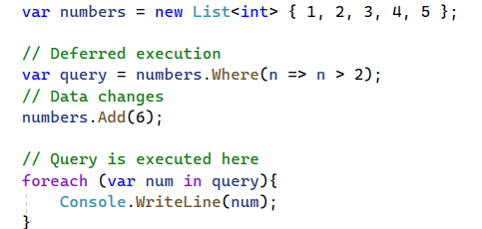
Linq - Deferred vs Immediate Execution
Deferred Execution: LINQ queries are not executed when they are defined. Instead, they are executed when the result is enumerated.
Queries are re-evaluated each time they are enumerated.
Useful for working with large datasets or when the data might change before execution.
www.bacancytechnology.com

Slide 101
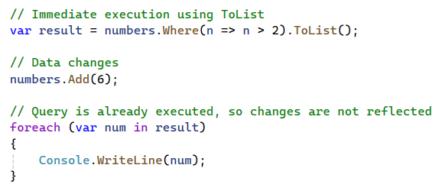
Linq - Deferred vs Immediate Execution
Immediate Execution: Forces the query to execute immediately and return the result as a collection (e.g., ToList, ToArray, ToDictionary)
Give results immediately and don’t want the query to be re-evaluated.
Useful for caching or small datasets.
www.bacancytechnology.com

Slide 102
Linq - Resources
Resource Link:
https://learn.microsoft.com/en-us/dotnet/csharp/linq/
https://dotnettutorials.net/lesson/introduction-to-linq/
https://www.javatpoint.com/linq
www.bacancytechnology.com

Slide 103
.Net core - Introduction
What is the ASP.NET Core?
ASP.NET Core is not an upgraded version of ASP.NET.
ASP.NET Core is completely rewriting that work with the .net Core framework. It is much faster, configurable, modular, scalable, extensible, and has cross-platform support.
It can work with both .NET Core and .net framework via the .NET standard framework. It is best suitable for developing cloud-based such as web applications, mobile applications, and IoT applications.
ASP.NET Core was primarily designed to make the most important part of the ASP.NET components under the concept learn and the compose framework where the previous ASP.NET components were released under a variety of different licenses periodically, The ASP.NET Core framework is a completely open-source framework.
Apart from the other parts of the framework of the .NET framework libraries, the ASP.NET Core is primarily designed from scratch to be the platform-agnostic that performs seamlessly. It will allow the ASP.NET Core apps to be deployed on the various platforms or the o/s such as the macOS or Linux-based servers or certain devices.
www.bacancytechnology.com

Slide 104
.Net core - Introduction
What are the differences between .NET Core and .NET Framework?
.NET Core | .NET Framework
Completely open-source. | Few components are open-source.
Compatible with Linux, Windows, and Mac operating systems. | Compatible with only Windows.
Does not support desktop application development. | Supports web and desktop application development.
Supports microservices development. | Supports web and desktop application development.
Lightweight for Command Line Interface (CLI). | Heavy for Command Line Interface.
Is flexible in installation, i.e. you can install components on a needed basis. | Must be installed as a whole package
www.bacancytechnology.com

Slide 105
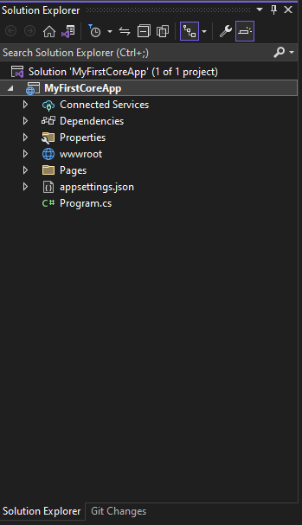
.Net core - Project Structure
Here, we will learn about the project structure and significance of each file created by ASP.NET Core 6.0 application template using Visual Studio 2022. The following is a default project structure when you create an empty ASP.NET Core application in Visual Studio.
Note: ASP.NET Core project files and folders are synchronized with physical files and folders. If you add a new file or folder in project folder then it will directly reflect in the solution explorer. You don't need to add it in the project explicitly by right clicking on the project.
.csproj
ASP.NET Core 6.0 no longer uses .xproj and project.json files. Instead, it fully utilizes the .csproj file to manage the project.
With the new version, you can edit the .csproj settings directly in Visual Studio or any text editor. To do so, right-click on the project in Visual Studio and select "Edit Project File" to modify the .csproj content.
www.bacancytechnology.com

Slide 106
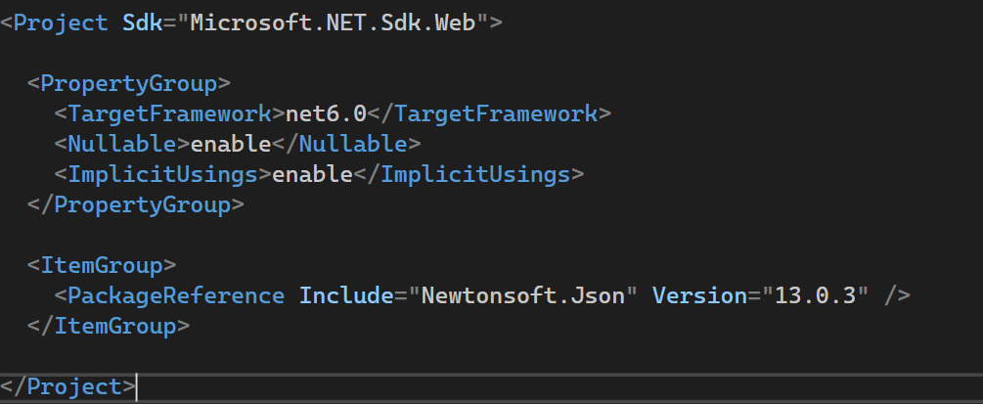
.Net core - Project Structure
This change was introduced in ASP.NET Core 2.0, and it carries forward into ASP.NET Core 6.0. The .csproj file now contains all the necessary project configuration and references, making it more streamlined and familiar for developers working with .NET projects.
The .csproj for the above project looks like below.
The .csproj file includes settings related to targeted .NET Frameworks, project folders, NuGet package references etc.
www.bacancytechnology.com

Slide 107
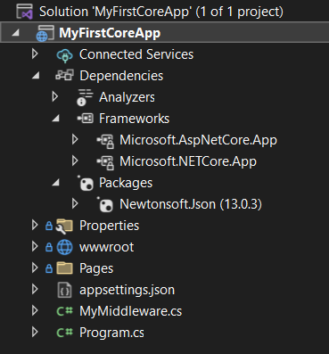
Nuget Package Manager
Dependencies: The Dependencies in the ASP.NET Core 6.0 project contain all the installed server-side NuGet packages, as shown below.
Right click on "Dependencies" and then click "Manage NuGet Packages.." to see the installed NuGet packages
You can install all other required server side dependencies as NuGet packages from Manage NuGet Packages window or using Package Manager Console.
www.bacancytechnology.com

Slide 108
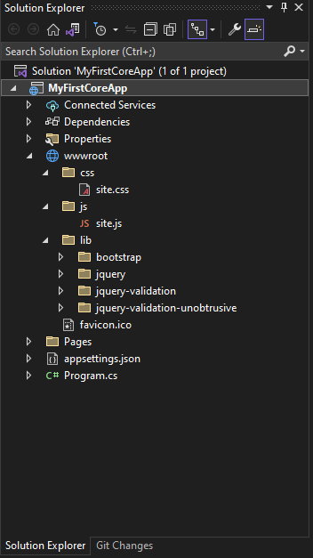
.Net core - Project Structure
ASP.NET Core - wwwroot Folder
By default, the wwwroot folder in the ASP.NET Core project is treated as a web root folder. Static files can be stored in any folder under the web root and accessed with a relative path to that root.
In the standard ASP.NET application, static files can be served from the root folder of an application or any other folder under it. This has been changed in ASP.NET Core. Now, only those files that are in the web root - wwwroot folder can be served over an http request. All other files are blocked and cannot be served by default.
Generally, there should be separate folders for the different types of static files such as JavaScript, CSS, Images, library scripts etc. in the wwwroot folder as shown in the given screenshot.
www.bacancytechnology.com

Slide 109
Routing in ASP.NET Core
What is Routing?
Mechanism to map incoming HTTP requests to the appropriate controller actions.
Types of Routing:
Conventional Routing
Attribute Routing
www.bacancytechnology.com

Slide 110
Routing in ASP.NET Core
Conventional Routing:
Defined in Startup.cs using app.UseEndpoints.
Follows a predefined pattern (e.g., {controller=Home}/{action=Index}/{id?}).
Attribute Routing:
Defined directly above controllers or actions using [Route] attribute.
More flexible and explicit.
www.bacancytechnology.com

Slide 111
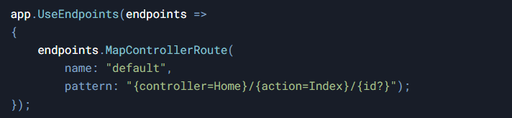
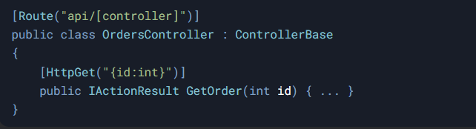
Routing in ASP.NET Core
Conventional Routing:
Attribute Routing:
www.bacancytechnology.com

Slide 112
Common Status Code And HTTP Verbs
Common Status Codes:
200 OK – Success
400 Bad Request – Invalid input
404 Not Found – Resource not found
500 Internal Server Error – Server error
Common HTTP Verbs:
GET – Retrieve data
POST – Create data
PUT – Update data
DELETE – Delete data
www.bacancytechnology.com

Slide 113
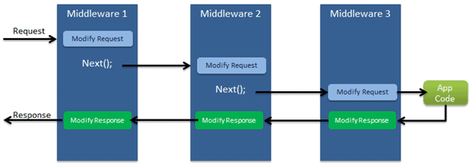
.Net core - Middleware
ASP.NET Core - Middleware: ASP.NET Core introduced a new concept called Middleware. A middleware is nothing but a component (class) which is executed on every request in ASP.NET Core application. In the classic ASP.NET, HttpHandlers and HttpModules were part of request pipeline. Middleware is similar to HttpHandlers and HttpModules where both needs to be configured and executed in each request.
Typically, there will be multiple middleware in ASP.NET Core web application. It can be either framework provided middleware, added via NuGet or your own custom middleware. We can set the order of middleware execution in the request pipeline. Each middleware adds or modifies http request and optionally passes control to the next middleware component. The following figure illustrates the execution of middleware components.
Middlewares build the request pipeline. The following figure illustrates the ASP.NET Core request processing.
www.bacancytechnology.com

Slide 114


.Net core - Middleware
Configure Middleware: We can configure middleware in the Program.cs file using WebApplication instance. The following example adds a single middleware using Run method which returns a string "Hello world from 1rst middleware" on each request.
In the given example, Run() is an extension method on WebApplication instance which adds a terminal middleware to the application's request pipeline. The above configured middleware returns a response with a string "Hello world from 1rst middleware" for each request.
www.bacancytechnology.com

Slide 115
.Net core - Middleware
Mostly there will be multiple middleware components in ASP.NET Core application which will be executed sequentially. The Run method adds a terminal middleware so it cannot call next middleware as it would be the last middleware in a sequence. The following will always execute the first Run method and will never reach the second Run method.
To configure multiple middleware, use Use() extension method. It is similar to Run() method except that it includes next parameter to invoke next middleware in the sequence.
Add Built-in Middleware Via NuGet: ASP.NET Core is a modular framework. We can add server side features we need in our application by installing different plug-ins via NuGet. There are many middleware plug-ins available which can be used in our application.
www.bacancytechnology.com

Slide 116
.Net core - Dependency Injection
ASP.NET Core - Dependency Injection: ASP.NET Core is designed from scratch to support Dependency Injection. ASP.NET Core injects objects of dependency classes through constructor or method by using built-in IoC container.
Built-in IoC Container
ASP.NET Core framework contains simple out-of-the-box IoC container which does not have as many features as other third party IoC containers. If you want more features such as auto-registration, scanning, interceptors, or decorators then you may replace built-in IoC container with a third party container.
The built-in container is represented by IServiceProvider implementation that supports constructor injection by default. The types (classes) managed by built-in IoC container are called services.
There are basically two types of services in ASP.NET Core:
Framework Services: Services which are a part of ASP.NET Core framework such as IApplicationBuilder, IHostingEnvironment, ILoggerFactory etc.
Application Services: The services (custom types or classes) which you as a programmer create for your application.
In order to let the IoC container automatically inject our application services, we first need to register them with IoC container.
www.bacancytechnology.com

Slide 117

.Net core - Dependency Injection
Registering Application Service: Consider the following example of simple ILog interface and its implementation class. We will see how to register it with built-in IoC container and use it in our application.
ASP.NET Core allows us to register our application services with IoC container, in the Program.cs there is a instance of WebApplicationBuilder and inside that there is Service property of type IServiceCollection, which is used to register application services.
www.bacancytechnology.com

Slide 118

.Net core - Dependency Injection
Let's register ILog with IoC container in Program.cs as shown below.
www.bacancytechnology.com

Slide 119
.Net core - Dependency Injection
Understanding Service Lifetime: Built-in IoC container manages the lifetime of a registered service type. It automatically disposes a service instance based on the specified lifetime.
The built-in IoC container supports three kinds of lifetimes:
Singleton: IoC container will create and share a single instance of a service throughout the application's lifetime.
Transient: The IoC container will create a new instance of the specified service type every time you ask for it.
Scoped: IoC container will create an instance of the specified service type once per request and will be shared in a single request.
Constructor Injection: Once we register a service, the IoC container automatically performs constructor injection if a service type is included as a parameter in a constructor.
www.bacancytechnology.com

Slide 120


.Net core - Dependency Injection
For example, we can use ILog service type in any MVC controller. Consider the following example.
In the provided example on the left, when working with an IoC container, the constructor of HomeController will be automatically provided with an instance of MyConsoleLogger. No additional manual intervention is required. Furthermore, the IoC container will handle the creation and disposal of an instance of ILog as per its registered lifetime.
Action Method Injection: In the example given on the right side, there might be situations where we only require the dependency service type within a specific action method. To achieve this, we can utilize the [FromServices] attribute along with the service type parameter in the method signature. This allows us to access the required service directly within that particular action method.
www.bacancytechnology.com

Slide 121

.Net core - Dependency Injection
Property Injection: Built-in IoC container does not support property injection. You will have to use third party IoC container.
Get Services Manually: It is not required to include dependency services in the constructor. We can access dependent services configured with built-in IoC container manually using RequestServices property of HttpContext as shown below.
It is recommended to use constructor injection instead of getting it using RequestServices.
www.bacancytechnology.com

Slide 122
.Net core - Dependency Injection
Property Injection: Built-in IoC container does not support property injection. You will have to use third party IoC container.
Get Services Manually: It is not required to include dependency services in the constructor. We can access dependent services configured with built-in IoC container manually using RequestServices property of HttpContext as shown below.
It is recommended to use constructor injection instead of getting it using RequestServices.
www.bacancytechnology.com

Slide 123

In this session
What we are learning in this session
Introduction
Create ASP.NET Core Web API
www.bacancytechnology.com

Slide 124
Introduction
Authentication is the process of validating user credentials, and authorization is the process of checking privileges for a user to access specific modules in an application. In this article, we will see how to protect an ASP.NET Core Web API application by implementing JWT authentication.
We will also see how to use authorization in ASP.NET Core to supply access to various functionalities of the application. We will store user credentials in an SQL server database, and we will use Entity Framework and Identity framework for database operations.
JSON Web Token (JWT) is an open standard (RFC 7519) that defines a compact and self-contained way for securely transmitting information between parties as a JSON object. This information can be verified and trusted because it is digitally signed. JWTs can be signed using a secret (with the HMAC algorithm) or a public/private key pair using RSA or ECDSA.
In its compact form, JSON Web Tokens consist of three parts separated by dots (.), which are:
Header
Payload
Signature
Therefore, a JWT typically looks: xxxx.yyyy.zzzz
www.bacancytechnology.com

Slide 125

Create ASP.NET Core Web API
We need Visual Studio 2022 to create .NET 6.0 applications. We can choose the ASP.NET Core Web API template from Visual Studio 2022.
www.bacancytechnology.com

Slide 126

Create ASP.NET Core Web API
We can give a suitable name for our project and choose the .NET 6.0 framework.
www.bacancytechnology.com

Slide 127
Create ASP.NET Core Web API
Our new project will be created in a few moments.
We must install the 4 libraries below into the new project.
Microsoft.EntityFrameworkCore.SqlServer
Microsoft.EntityFrameworkCore.Tools
Microsoft.AspNetCore.Identity.EntityFrameworkCore
Microsoft.AspNetCore.Authentication.JwtBearer
You can use the NuGet package manager to install the above packages.
We can change the appsettings.json with values below. It has database connection details and other details for JWT authentication.
www.bacancytechnology.com

Slide 128

Create ASP.NET Core Web API
appsettings.json
www.bacancytechnology.com

Slide 129

Create ASP.NET Core Web API
We can create a new folder, “Auth” and create the “ApplicationDbContext” class under Auth folder and add below code. We will add all the classes related to authentication under the Auth folder.
ApplicationDbContext.cs
www.bacancytechnology.com

Slide 130

Create ASP.NET Core Web API
Create a static class “UserRoles” and add below values.
UserRoles.cs
We have added two constant values “Admin” and “User” as roles. You can add as many roles as you wish.
www.bacancytechnology.com

Slide 131

Create ASP.NET Core Web API
Create class “RegisterModel” for new user registration.
RegisterModel.cs
www.bacancytechnology.com

Slide 132

Create ASP.NET Core Web API
Create class “LoginModel” for user login.
LoginModel.cs
www.bacancytechnology.com

Slide 133

Create ASP.NET Core Web API
We can create a class “Response” for returning the response value after user registration and user login. It will also return error messages if the request fails.
Response.cs
We can create an API controller “AuthenticateController” inside the “Controllers” folder. Kindly check mentioned controller in Source Code.
www.bacancytechnology.com

Slide 134

Create ASP.NET Core Web API
We have added three methods “login”, “register”, and “register-admin” inside the controller class. Register and register-admin are almost same, but the register-admin method will be used to create a user with admin role. In login method, we have returned a JWT token after successful login.
In .NET 6.0, Microsoft removed the Startup class and only kept Program class. We must define all our dependency injection and other configurations inside the Program class. Kindly check mentioned file in Source Code.
We must create a database and tables needed before running the application. As we are using entity framework, we can use below database migration command with package manger console to create a migration script.
add-migration Initial
www.bacancytechnology.com

Slide 135

Create ASP.NET Core Web API
Use the command below to create database and tables.
update-database
If you check the database using SQL server object explorer, you can see that the tables below are created inside the database.
There are 7 tables created for User, Role and Claims during the database migration process. This is due to the Microsoft Identity framework.
ASP.NET Core Identity is a membership system which allows you to add login functionality to your application. Users can create an account and login with a username and password, or they can use an external login provider such as Facebook, Google, Microsoft Account, Twitter and more.
You can configure ASP.NET Core Identity to use a SQL Server database to store usernames, passwords, and profile data.
www.bacancytechnology.com

Slide 136


Create ASP.NET Core Web API
We can add “Authorize” attribute inside the “WeatherForecast” controller.
We can add “Authorize” attribute inside the “WeatherForecast” controller.
www.bacancytechnology.com

Slide 137


Create ASP.NET Core Web API
We have received a 401 unauthorized error. Because, we have added Authorize attribute to entire controller. We must supply a valid token via request header to access this controller and methods inside the controller.
We can create a new user using a register method in authenticate controller.
www.bacancytechnology.com

Slide 138


Create ASP.NET Core Web API
We have supplied the input data as raw JSON format.
We can use the above user credentials to login and get a valid JWT token.
www.bacancytechnology.com

Slide 139

Create ASP.NET Core Web API
We have received a token after successful login with the above credentials.
We can decode the token and see the claims and other information using https://jwt.io site.
www.bacancytechnology.com

Slide 140

Create ASP.NET Core Web API
www.bacancytechnology.com

Slide 141

Create ASP.NET Core Web API
We can pass the above token value as a Bearer token inside the authorization tab and call get method of weatherforecast controller again.
www.bacancytechnology.com

Slide 142

Create ASP.NET Core Web API
This time, we have successfully received the values from the controller.
We can change the weatherforecast controller with role-based authorization.
Now, only users with admin role can access this controller and methods.
We can try to access the weatherforecast controller with same token again in Postman tool.
www.bacancytechnology.com

Slide 143

Create ASP.NET Core Web API
We have received a 403 forbidden error instead of 401 now. Even though we are passing a valid token we don’t have sufficient privilege to access the controller. To access this controller, the user must have an admin role permission. Current user is a normal user and does not have any admin role permission.
We can create a new user with an admin role permission. We already have a method “register-admin” in authenticate controller for the same purpose.
www.bacancytechnology.com

Slide 144

Create ASP.NET Core Web API
We can use this token instead of the old token to access the weatherforecast controller.
www.bacancytechnology.com

Slide 145

Create ASP.NET Core Web API
Now we have successfully fetched the data from weatherforecast controller.
www.bacancytechnology.com

Slide 146
SQL Server - Introduction
SQL Server is a relational database management system, or RDBMS, developed and marketed by Microsoft.
Similar to other RDBMS software, SQL Server is built on top of SQL, a standard programming language for interacting with relational databases.
SQL Server is built for the basic function of storing retrieving data as required by other applications. It can be run either on the same computer or on another across a network.
www.bacancytechnology.com

Slide 147

SQL Server - Data Type
In SQL Server, data type specifies the type of data that can be stored in a column of a table such as integer data, string data, date & time, binary strings, etc.
Assigning an appropriate data type to columns in a table is crucial while designing a database. It affects the performance and efficiency of the database and the application using the database.
SQL Server provides built-in data types for all kinds of data that can be used within SQL Server.
www.bacancytechnology.com

Slide 148
SQL Server - Naming Conventions
SQL Server defines a set of rules (dos and don'ts) for naming SQL Server Objects called naming convention, but also gives the user to follow their own preferred style. It is advisable to follow a single naming convention for all database objects consistently.
Why Use Naming Conventions?
Naming convention for tables, columns, and all other related database objects like views, stored procedures, indexes, triggers, etc., are important for the success and maintenance of a project. A database can have many tables and users working on it.
By following a naming convention, you can spend less time finding what you need and helps in efficient database management.
SQL Server Database Object Naming Rules:
Names of database objects such as tables, columns, stored procedures, views, etc, can contain alphanumeric characters and must begin with an alphabet or an underscore.
Case sensitivity is determined by the settings of the database in which the object is created. By default, SQL Server is not case sensitive.
A name that starts with the 'at' (@) sign always denotes a local variable or parameter and cannot be used as a name for any other type of object.
www.bacancytechnology.com

Slide 149
SQL Server - Naming Conventions
A name that begins with the number sign (#) denotes a temporary table or procedure.
The Object name should not be a SQL reserved word. SQL Server reserves both lowercase and uppercase versions of reserved words.
Some system procedures and functions are given prefixes like 'sp_', 'xp_', or 'dt_' to signify that they are system objects and should be searched for in the master database. So it is better to avoid using these prefixes while creating database objects.
There are a few commonly accepted styles to name a table & column in a database. It can be all ‘lower case’, 'UPPERCASE', 'Pascal Case' or 'camel Case'.
Avoid using spaces between words for table names and columns as they will require square brackets and confuse scripts and procedures. Instead, use an underscore for joining multiple words. For example, EMPLOYEE_SKILL, employee_id instead of [EMPLOYEE ID].
Avoid using prefixes like 'tbl_' for table names.
While naming columns, use nouns that describe what is stored in the column.
Example: FIRST_NAME, ADDRESS, EMAIL, PHONE. Avoid using words that are just data types like text or date.
www.bacancytechnology.com

Slide 150

SQL Server - Tables Relations
It is important to understand and design relationships among tables in a relational database like SQL Server. In a relational database, each table is connected to another table using the Primary-Foreign Key constraints.
Table relationships in SQL Server database are of three types: One-to-One, One-to-Many, and Many-to-Many
1). One-to-One: In One-to-One relationship, one record of the first table will be linked to zero or one record of another table.
For example, each employee in the Employee table will have a corresponding row in EmployeeDetails table that stores the current passport details for that particular employee.
Each employee will have zero or one record in the EmployeeDetails table. This is called zero or one-to-one relationship.
www.bacancytechnology.com

Slide 151
SQL Server - Tables Relations
Above, EmployeeID column is the primary key as well as foreign key column in the EmployeeDetails table that linked to EmployeeID of the Employee table. This forms zero or one-to-one relation.
2). One-to-Many Relation: One-to-Many is the most commonly used relationship among tables. A single record from one table can be linked to zero or more rows in another table.
Let's take an example of the Employee and Address table in the database. The Employee table stores employee records where EmployeeID is the primary key. The Address table holds the addresses of employees where AddressID is a primary key and EmployeeID is a foreign key. Each employee will have one record in the Employee table. Each employee can have many addresses such as Home address, Office Address, Permanent address, etc.
The Employee and Address tables are linked by the key column EmployeeID. It is a foreign key in the Address table linking to the primary key EmployeeID in the Employee table. Thus, one record of the Employee table can point to multiple records in the Address table. This is a One-to-Many relationship.
www.bacancytechnology.com

Slide 152

SQL Server - Tables Relations
3). Many-to-Many Relation: Many-to-Many relationship lets you relate each row in one table to many rows in another table and vice versa. As an example, an employee in the Employee table can have many skills from the EmployeeSkill table and also, one skill can be associated with one or more employees.
The following figure demonstrates many-to-many relation between Employee and SkillDescription table using the junction table EmployeeSkill.
www.bacancytechnology.com

Slide 153

SQL Server - Tables Relations
Every employee in the Employee table can have one or many skills. Similarly, a skill in the SkillDescription table can be linked to many employees. This makes a many-to-many relationship.
In the example above, the EmployeeSkill is the junction table that contains EmployeeID and SkillID foreign key columns to form many-to-many relation between the Employee and SkillDescription table.
www.bacancytechnology.com

Slide 154
SQL Server - Keys
1). Primary Keys: In SQL Server, a Primary key is a constraint that uniquely identify each row in the table. It enforce data integrity in tables.
A table can have only one primary key.
A primary key can be defined on one column or the combination of multiple columns known as a composite primary key.
The primary key uniquely identifies each row in a table. It is often defined on the identity column.
The Primary key column do not allow NULL or duplicate values. It will raise an error if try to do so.
All columns defined within the primary key constraint must be defined as a NOT NULL column.
If clustered or nonclustered is not specified, then a unique clustered index for the primary key column will be created if there no clustered index on the table. This makes retrieving data faster whenever the primary key column is included in the query.
Create a Primary Key: A primary key can be configured in the create table SQL script. Append CONSTRAINT statement at the end of all column declaration.
www.bacancytechnology.com

Slide 155
SQL Server - Keys
Syntax: CONSTRAINT <primarykey_name> PRIMARY KEY [CLUSTERED | NONCLUSTERED] (<column_names>)
The name of a primary key should be in PK_TableName_ColumnName format to recognize it easily.
Create a Primary Key in an Existing Table: Use the ALTER TABLE statement to add a primary key in an existing table.
Syntax: ALTER TABLE Employee
ADD CONSTRAINT PK_Employee_EmployeeID PRIMARY KEY (EmployeeID)
2). Foreign Keys: The foreign key establishes the relationship between the two tables and enforces referential integrity in the SQL Server. For example, the following Employee table has a foreign key column DepartmentID that links to a primary key column of the Department table.
A foreign key column can be linked to a primary key or a unique key column of the same or another table.
The table having the foreign key constraint is called the child table, and the table being referenced by the foreign key is called the parent table. E.g. Employee is a child table and Department is a parent table.
www.bacancytechnology.com

Slide 156

SQL Server - Keys
A value other than NULL is entered in the column of the foreign key constraint, that value must already exist in the referenced column of the parent table. Else you will get a foreign key violation error.
A foreign key constraint defined at the table level (on a combination of columns) should have the same number of reference columns as the number of columns defined in the constraint list. The data type of each column in the constraint must be the same as the corresponding column in the column list.
There is no limit on the number of foreign key constraints a table can contain that references other tables. However, it is limited by the hardware configuration and the database design.
www.bacancytechnology.com

Slide 157
SQL Server - Keys
Foreign key constraints are not enforced on temporary tables.
3). Unique Keys: The Unique Constraint ensures the uniqueness of all values and no duplicate values are entered in a column of a table.
The unique constraints can be created using CREATE or ALTER TABLE SQL. Add unique constraints after columns definitions in the CREATE TABLE statement.
Syntax: CONSTRAINT <constraint_name> UNIQUE(<column_name>)
Important Points:
Both Unique constraint and Primary key constraint enforce uniqueness. It is recommended to use Unique constraint instead of Primary key constraint whenever you want to enforce uniqueness in a column.
Unlike Primary key constraint, Unique constraints allow only one NULL value.
A unique index is automatically created when a unique key constraint is created.
SQL Server raises an error whenever a duplicate value is inserted or updated.
www.bacancytechnology.com

Slide 158
SQL Server - Keys
Important Points:
When a Unique index is added to an existing column in a table, the database engine first checks for the uniqueness of the specified column data. If a duplicate entry is found, then the engine returns an error and does not add the constraint.
A Unique key in a table can be referenced by a Foreign Key from another table.
www.bacancytechnology.com

Slide 159
Achieved
In this course
What we are learning in this session
Views
Functions
Stored Procedures
Indexes
Joins
Create Database
Create Table
www.bacancytechnology.com

Slide 160
SQL Server - Views
In SQL Server, a view is a virtual table whose values are defined by a query. In another word, a view is a name given to a query that can be used as a table. The rows and columns of a view come from tables referenced by a query.
Syntax:
CREATE VIEW <schema_name>.<view_name>
AS
SELECT column1, column2, ...
FROM table1, table2,...
[WHERE];
Types of Views:
1). User-defined Views
2). Indexed Views
3). Partitioned Views
4). System Views
Important Points:
Unless indexed, a view does not exist as a stored set of data values in a database.
Views can be created by using tables or other views in the current or other databases.
The SQL statements comprising the view are stored in the database and not the resulting data.
The data from a view is generated dynamically when a view is referenced.
Views are used as a security mechanism to mask the underlying base tables and permit user access only to the view.
www.bacancytechnology.com

Slide 161
SQL Server - Functions
Functions in SQL Server are similar to functions in other programming languages. Functions in SQL Server contains SQL statements that perform some specific tasks. Functions can have input parameters and must return a single value or multiple records.
If your scripts use the same set of SQL statements repeatedly then this can be converted into a function in the database.
Types of Functions:
SQL Server Functions are of two types.
1). System Functions: These are built-in functions available in every database. Some common types are Aggregate functions, Analytic functions, Ranking functions, Rowset functions, Scalar functions.
2). User Defined Functions (UDFs): Functions created by the database user are called User-defined functions. UDFs are of two types:
www.bacancytechnology.com

Slide 162
SQL Server - Functions
2.1). Scalar functions: The function that returns a single data value is called a scalar function.
2.2). Table-valued functions: The function that returns multiple records as a table data type is called a Table-valued function. It can be a result set of a single select statement.
Advantage of User-defined Functions:
Faster Execution: Similar to stored procedures, UDFs reduce the compilation cost of T-SQL by caching the plans and reusing them for future executions.
Reduce Network Traffic: The SQL statements of a function execute in the database, and the application calling it needs to make a function call to the database.
Supports Modular Programming: UDFs can be modified independently of the application source code. You can create UDFs once and store them in the database, and they can be called any number of times.
www.bacancytechnology.com

Slide 163
SQL Server - Stored Procedures
In SQL Server, a stored procedure is a set of T-SQL statements which is compiled and stored in the database. The stored procedure accepts input and output parameters, executes the SQL statements, and returns a result set if any.
By default, a stored procedure compiles when it gets executed for the first time. It also creates an execution plan that is reused for subsequent executions for faster performance.
Stored procedures are of two types:
1). User-defined procedures: A User-defined stored procedure is created by a database user in a user-defined database or any System database except the resource database.
2). System procedures: System procedures are included with SQL Server and are physically stored in the internal, hidden Resource database and logically appear in the sys schema of all the databases. The system stored procedures start with the sp_ prefix.
Create Stored Procedure:
Use the CREATE statement to create a stored procedure.
www.bacancytechnology.com

Slide 164
SQL Server - Stored Procedures
Syntax:
CREATE [OR ALTER] {PROC | PROCEDURE} [schema_name.] procedure_name([@parameter data_type [ OUT | OUTPUT | [READONLY]] [ WITH <procedure_option> ]
[ FOR REPLICATION ]
AS
BEGIN
sql_statements
END
Advantages of Stored procedures:
Stored procedures are reusable. Multiple users in multiple applications can use the same Stored Procedure.
SPs reside in the database, it reduces network traffic. Applications have to make a procedure call to the database and it communicates back to the user.
www.bacancytechnology.com

Slide 165
SQL Server - Stored Procedures
Advantages of Stored procedures:
Database objects are encapsulated within a stored procedure, and this acts as a security mechanism by restricting access to the database objects. Reduced development cost, easily modified, and increased readability.
Improves performance. When a stored procedure is executed for the first time, the database processor creates an execution plan which is reused every time this SP is executed.
www.bacancytechnology.com

Slide 166
SQL Server - Indexes
An Index in SQL Server is a data structure associated with tables and views that helps in faster retrieval of rows.
Data in a table is stored in rows in an unordered structure called Heap. If you have to fetch data from a table, the query optimizer has to scan the entire table to retrieve the required row(s). If a table has a large number of rows, then SQL Server will take a long time to retrieve the required rows. So, to speed up data retrieval, SQL Server has a special data structure called indexes.
An index is mostly created on one or more columns which are commonly used in the SELECT clause or WHERE clause.
There are two types of indexes in SQL Server:
Clustered Indexes, and Non-Clustered Indexes
Clustered Indexes:
The clustered index defines the order in which the table data will be sorted and stored. As mentioned before, a table without indexes will be stored in an unordered structure. When you define a clustered index on a column, it will sort data based on that column values and store it. Thus, it helps in faster retrieval of the data.
www.bacancytechnology.com

Slide 167
SQL Server - Indexes
There can be only one clustered index on a table because the data rows can be stored in only one order.
When you create a Primary Key constraint on a table, a unique clustered index is automatically created on the table.
Syntax: CREATE CLUSTERED INDEX <index_name>
ON [schema.]<table_name>(column_name [asc|desc]);
Non-Clustered Indexes:
SQL Server provides two types of indexes, clustered and non-clustered indexes. Here you will learn non-clustered indexes.
The non-clustered index does not sort the data rows physically. It creates a separate key-value structure from the table data where the key contains the column values (on which a non-clustered index is declared) and each value contains a pointer to the data row that contains the actual value. It is similar to a textbook having an index at the back of the book with page numbers pointing to the actual information.
www.bacancytechnology.com

Slide 168
SQL Server - Indexes
There can be 999 non-clustered indexes on a single table is 999. When you create a Unique constraint, a unique non-clustered index is created on the table.
Syntax: CREATE NONCLUSTERED INDEX <index_name>
ON <table_name>(column)
When you create a Primary Key constraint on a table, a unique clustered index is automatically created on the table.
Syntax: CREATE CLUSTERED INDEX <index_name>
ON [schema.]<table_name>(column_name [asc|desc]);
www.bacancytechnology.com

Slide 169


SQL Server - Joins
SQL Server joins are essential for retrieving data from multiple tables in a relational database. They allow you to combine rows from two or more tables based on a related column between them.
1). INNER JOIN: An INNER JOIN returns only the rows that have matching values in both tables.
2). LEFT JOIN (or LEFT OUTER JOIN): A LEFT JOIN returns all rows from the left table and the matched rows from the right table. If there's no match, it returns NULL for columns from the right table.
www.bacancytechnology.com

Slide 170


SQL Server - Joins
3). RIGHT JOIN (or RIGHT OUTER JOIN): A RIGHT JOIN returns all rows from the right table and the matched rows from the left table. If there's no match, it returns NULL for columns from the left table.
4). FULL OUTER JOIN: A FULL OUTER JOIN returns all rows when there is a match in either the left or the right table. If there's no match, it returns NULL for columns from the table without a match.
www.bacancytechnology.com

Slide 171


SQL Server - Joins
5). SELF JOIN: A SELF JOIN is used to join a table with itself. It's often used when you have hierarchical or parent-child relationships within a table.
6). CROSS JOIN: A CROSS JOIN returns the Cartesian product of two tables, meaning it combines every row from the first table with every row from the second table.
www.bacancytechnology.com

Slide 172
Create Database
In SQL Server, a database is made up of a collection of objects like tables, functions, stored procedures, views etc. Each instance of SQL Server can have one or more databases. SQL Server databases are stored in the file system as files.
A login is used to gain access to a SQL Server instance and a database user is used to access a database. SQL Server Management Studio is widely used to work with a SQL Server database.
Type of Database in SQL Server There are two types of databases in SQL Server: System Database and User Database.
System databases are created automatically when SQL Server is installed. They are used by SSMS and other SQL Server APIs and tools, so it is not recommended to modify the system databases manually. The followings are the system databases:
master: master database stores all system level information for an instance of SQL Server. It includes instance-wide metadata such as logon accounts, endpoints, linked servers, and system configuration settings.
www.bacancytechnology.com

Slide 173
Create Database
The followings are the system databases:
model: model database is used as a template for all databases created on the instance of SQL Server
msdb: msdb database is used by SQL Server Agent for scheduling alerts and jobs and by other features such as SQL Server Management Studio, Service Broker and Database Mail.
tempdb: tempdb database is used to hold temporary objects, intermediate result sets, and internal objects that the database engine creates.
User-defined Databases are created by the database user using T-SQL or SSMS for your application data. A maximum of 32767 databases can be created in an SQL Server instance.
You can execute the SQL script in the query editor using Master database.
Syntax: USE master;
CREATE <database-name>
www.bacancytechnology.com

Slide 174
Create Table
Tables are database objects that contain all the data in a database. In a table, data is logically organized in rows and columns. Each column represents a field and each row represents a unique record. Each column has a data type associated with it. It represents the type of data in that column. Each table is uniquely named in a database.
Number of tables in a database is only limited by the number of objects allowed in the database (2,147,483,647). A user-defined table can have up to 1024 columns.
You can execute the CREATE TABLE statement in the query editor of SSMS to create a new table in SQL Server.
Syntax: CREATE TABLE [database_name.][schema_name.]table_name (
pk_column_name data_type PRIMARY KEY,
column_name2 data_type [NULL | NOT NULL],
column_name3 data_type [NULL | NOT NULL],
...,
[table_constraints]
);
www.bacancytechnology.com

Slide 175
Create Table
Tables are database objects that contain all the data in a database. In a table, data is logically organized in rows and columns. Each column represents a field and each row represents a unique record. Each column has a data type associated with it. It represents the type of data in that column. Each table is uniquely named in a database.
www.bacancytechnology.com

Slide 176
Achieved
In this course
What we are learning in this session
Transactions - TCL Command
Error Handling in SQL
CTE
Temp Table
Variables
Constraints
Clustered vs Nonclustered
Trigger
Cursor
www.bacancytechnology.com

Slide 177

SQL Command
SQL commands are instructions. It is used to communicate with the database. It is also used to perform specific tasks, functions, and queries of data.
DDL (Data Definition Language)
DML (Data Manipulation Language)
DCL (Data Control Language)
TCL (Transaction Control Language)
DQL(Data Query Language)
www.bacancytechnology.com

Slide 178

Table - DDL Command

Slide 179
DDL Command
In SQL, a table is a structured representation of data organized into rows and columns. It is a fundamental database object used to store, manage, and retrieve information.
Create Table :
CREATE TABLE employees (
employee_id INT PRIMARY KEY,
employee_name VARCHAR(50),
department VARCHAR(30),
salary DECIMAL(10, 2)
)
Alter Table:
ALTER TABLE employees ADD hire_date DATE
www.bacancytechnology.com

Slide 180
DDL Command
Drop Table:
DROP TABLE employees
DROP is used to delete database objects, such as tables, views, indexes, or databases themselves.
Truncate Table:
TRUNCATE TABLE employees
TRUNCATE is used to remove all records from a table but retains the table structure for future use. When we use TRUNCATE it will reset column identity.
Syntax:
DELETE FROM your_table WHERE condition TRUNCATE TABLE your_table
DELETE is a row-by-row operation allowing conditional removal, while TRUNCATE efficiently removes all rows in one operation without conditions but may not be suitable if foreign key constraints are present or if you need to log individual deletions.
www.bacancytechnology.com

Slide 181
DQL & DML Command

Slide 182
DQL & DML
DML (Data Manipulation Language) commands in SQL Server are used to interact with and manipulate data stored in tables.
SELECT EmployeeID, FirstName, LastName, Salary, DepartmentID
FROM Employee
WHERE DepartmentID = 1
INSERT INTO Employee (FirstName, LastName, Salary, DepartmentID)
VALUES ('John', 'Doe', 50000, 2)
UPDATE Employee
SET Salary = 55000
WHERE EmployeeID = 101
DELETE FROM Employee
WHERE EmployeeID = 102
www.bacancytechnology.com

Slide 183
DQL & DML
ORDER BY : Retrieve all employees sorted by their salary in descending order. Default order type is ascending.
SELECT * FROM Employee
ORDER BY Salary DESC
GROUP BY : Count the number of employees in each department
SELECT Department, COUNT(*) AS EmployeeCount
FROM Employee
GROUP BY Department
DISTINCT : Retrieve unique departments from the Employee table
SELECT DISTINCT Department
FROM Employee
SUM, AVG, MIN, MAX
SELECT SUM(Salary) AS TotalSalary, AVG(Salary) AS AvgSalary,
MIN(Salary) AS MinSalary, MAX(Salary) AS MaxSalary
FROM Employee
www.bacancytechnology.com

Slide 184


Slide 185
DCL Command

Slide 186
DCL
DCL (Data Control Language) commands in SQL are used to control access to the data within a database.
GRANT SELECT, INSERT ON Employee TO user1
REVOKE DELETE ON Employee FROM user2
www.bacancytechnology.com

Slide 187
TCL Command

Slide 188

TCL
TCL (Transaction Control Language) commands in SQL are used to manage transactions.
COMMIT: Saves all the changes made during the current transaction to the database.
ROLLBACK: Undoes all changes made during the current transaction, reverting the database to its state before the transaction started.
SAVEPOINT: Sets a named point within a transaction to which you can later roll back.
ROLLBACK TO SAVEPOINT: Rolls back the transaction to a specified savepoint.
www.bacancytechnology.com

Slide 189
Error Handling

Slide 190
Error Handling in SQL
Error handling in SQL Server gives us control over the Transact-SQL code. For example, when things go wrong, we get a chance to do something about it and possibly make it right again.
Why Error Handling?
✅ Prevents unexpected failures
✅ Helps in debugging & troubleshooting
✅ Ensures data consistency
✅ Improves user experience
Types of Errors:
❌ Syntax Errors – Incorrect SQL syntax ❌ Runtime Errors – Division by zero, type mismatches ❌ Logical Errors – Incorrect business logic
www.bacancytechnology.com

Slide 191
Error Handling in SQL
Error Handling Methods:
1️⃣ TRY...CATCH – Handles runtime errors
2️⃣ RAISEERROR & THROW – Raises custom errors
3️⃣ @@ERROR – Retrieves error codes
TRY...CATCH Block (Example):
BEGIN TRY
SELECT 1/0 -- Division by zero error
END TRY
BEGIN CATCH
PRINT 'Error: ' + ERROR_MESSAGE()
END CATCH
www.bacancytechnology.com

Slide 192
CTE (Common Table Expression)

Slide 193
CTE
A Common Table Expression is a temporary result set that you can reference within a SELECT, INSERT, UPDATE, or DELETE statement
CTEs are particularly useful for making complex queries more readable and maintainable by breaking them down into smaller, logical units. They can also be recursive, allowing you to perform hierarchical queries.
WITH SalesCTE (Product, TotalSales) AS (
SELECT Product, SUM(SalesAmount) AS TotalSales
FROM Sales
GROUP BY Product )
SELECT * FROM SalesCTE
www.bacancytechnology.com

Slide 194
CTE
Benefits :
CTEs make code more readable. And readability makes queries easier to debug.
CTEs can reference the results multiple times throughout the query. By storing the results of the subquery, you can reuse them throughout a larger query.
CTEs can help you perform multi-level aggregations. Use CTEs to store the results of aggregations, which you can then summarize in the main query.
Reference
https://stackoverflow.com/questions/54176/what-are-the-advantages-disadvantages-of-using-a-cte
www.bacancytechnology.com

Slide 195
Temp Table

Slide 196
Temp Table
In SQL Server, a temporary table is a table that is created and exists only for the duration of a session or a specific scope of work. Temporary tables are particularly useful when you need to store and manipulate intermediate results within a specific operation, and you don't want to clutter the permanent database with such temporary data.
Use Cases for Temporary Tables:
Complex Queries: Temporary tables can be used to store intermediate results during complex queries, improving readability and performance.
Transaction Isolation: Temporary tables can help isolate data within a transaction, preventing interference with other transactions.
Reusability: Temporary tables allow you to reuse the same set of data within a session without having to recreate the table structure.
Temporary Storage: Storing data temporarily for a specific process or reporting task.
www.bacancytechnology.com

Slide 197
Temp Table
Types of Temp Table :
Local Temporary Table :
Local temp tables are similar to Permanent Tables in SQL Server, it accepts the single hash value "#" as the prefix when created. They are visible only to the connection that creates it, and are deleted when the connection is closed.
CREATE TABLE #TempTable (
ID INT,
Name VARCHAR(255)
)
INSERT INTO #TempTable VALUES (1, 'John'), (2, 'Jane')
SELECT * FROM #TempTable
DROP IF EXITS TABLE #TempTable
SELECT * INTO #TempTable FROM Employee
www.bacancytechnology.com

Slide 198
Temp Table
2. Global Temporary Table
Global Temporary Tables are also similar to Local Temporary Tables in SQL Server, except two "##" values are used as the prefix at the time of their creation. They are visible to all connections of SQLServer and only destroyed when the last connection referencing the table is closed (in which we have created the Global Temporary Table).
CREATE TABLE ##GlobalTempTable (
ID INT,
Name VARCHAR(255)
)
INSERT INTO ##GlobalTempTable VALUES (1, 'Mike'), (2, 'Sara')
SELECT * FROM ##GlobalTempTable
DROP IF EXITS TABLE ##GlobalTempTable
SELECT * INTO ##GlobalTempTable FROM Employee
www.bacancytechnology.com

Slide 199
Variables

Slide 200
Variable
Variable is a storage location with a name that you assign to it. It is used to store and manipulate data temporarily within the scope of a batch, stored procedure, function, or trigger. Variables provide a way to pass data between different parts of a script or stored procedure, making the code more flexible and dynamic.
DECLARE @MyVariable INT
SET @MyVariable = 42
www.bacancytechnology.com

Slide 201
Variable
 | Temporary Tables | Variables
Scope | Temporary tables are visible across sessions and can be used by multiple queries within the same session. | Variables have a narrower scope and are typically limited to the batch or stored procedure in which they are declared.
Data Persistence | Data in temporary tables persists until the session ends or the table is explicitly dropped. | Data stored in variables only persists for the duration of the batch or procedure execution.
Performance | using temporary tables might introduce additional overhead, as they involve disk I/O (writing to tempdb). | variables have lower overhead as they are stored in memory.
www.bacancytechnology.com

Slide 202
Constraints

Slide 203
Constraints
Constraints in SQL Server are predefined rules and restrictions that are enforced in a single column or multiple columns, regarding the values allowed in the columns, to maintain the integrity, accuracy, and reliability of that column’s data.
Types of Constraints:
PRIMARY KEY - Ensures unique, non-null values in a column
FOREIGN KEY - Maintains referential integrity between tables
UNIQUE - Ensures all values in a column are unique
CHECK - Enforces a specific condition on column values
DEFAULT - Assigns a default value if none is provided
NOT NULL - Ensures a column cannot store NULL values
www.bacancytechnology.com

Slide 204
Clustered vs Non-Clustred

Slide 205
Clustered vs Non clustered
What is an Index?
Improves query performance by organizing data efficiently
Two main types: Clustered and Non-Clustered
Feature | Clustered Index | Non-Clustered Index
Data Storage | Stores actual data in sorted order | Stores pointers to actual data
Number per Table | Only 1 per table | Multiple allowed
Speed | Faster for SELECT queries | Slower than clustered for large data
Usage | Ideal for primary keys | Useful for search columns
Example | PRIMARY KEY creates a clustered index | CREATE INDEX creates a non-clustered index
-- Clustered Index (Automatically created on PK)
CREATE TABLE Employees (
EmployeeID INT PRIMARY KEY,
Name NVARCHAR(50)
);
-- Non-Clustered Index
CREATE NONCLUSTERED
INDEX IX_Employees_Name
ON Employees(Name);
www.bacancytechnology.com

Slide 206
Trigger

Slide 207
Trigger
A trigger is a special type of stored procedure that automatically runs when an event occurs in the database server. DML triggers run when a user tries to modify data through a data manipulation language (DML) event. DML events are INSERT, UPDATE, or DELETE statements on a table or view.
DDL triggers run in response to a variety of data definition language (DDL) events. These events primarily correspond to Transact-SQL CREATE, ALTER, and DROP statements
Reference
https://www.sqlshack.com/triggers-in-sql-server/
https://learn.microsoft.com/en-us/sql/t-sql/statements/create-trigger-transact-sql?view=sql-server-ver16
www.bacancytechnology.com

Slide 208
Trigger
Advantages of Triggers
Enforcing Business Rules: Triggers can be used to enforce business rules by automatically checking and validating data before it is inserted, updated, or deleted. This helps maintain data integrity.
Audit Log: Triggers can be employed to maintain an audit log of changes, tracking who made the changes and when. This is beneficial for compliance and debugging purposes.
Synchronization of Data: Triggers can be used to synchronize data across different tables or databases when changes are made, ensuring consistency.
Disadvantages or Drawbacks of Triggers
Performance Impact: Triggers can introduce performance overhead because they add additional processing during data modification operations.
Hidden Logic: Triggers contain logic that is not immediately evident when examining the SQL statements for a given operation. This can make it challenging to understand and debug the overall system logic.
www.bacancytechnology.com

Slide 209
Cursor

Slide 210
Cursor
Cursor is a database object that allows us to iterate over a result set, row by row, and perform operations on each row individually. Cursors are typically used within Transact-SQL (T-SQL) scripts or stored procedures to process data sequentially.
Forward-Only Cursor
Static Cursor
Dynamic Cursor
Keyset-Driven Cursor
Scrollable Cursor
Reference
https://learn.microsoft.com/en-us/sql/relational-databases/cursors?view=sql-server-ver16
www.bacancytechnology.com

Slide 211
Cursor
Advantages of Cursors
Explicit Control: Cursors provide explicit control over the fetching, updating, and deleting of rows. This can be useful in situations where we need fine-grained control over data manipulation.
Scrolling: Cursors provide the ability to move back and forth through the result set, allowing for more flexible navigation compared to a simple query.
Disadvantages of Cursors
Performance Overhead: Cursors can result in poor performance, especially when processing large result sets, as they may require additional resources and increase database load.
Blocking: Cursors can lead to increased locking and blocking issues, especially in concurrent environments, where other transactions may be affected by the locks held by the cursor.
Complexity: Code using cursors tends to be more complex and harder to maintain than set-based operations. SQL is designed to work with sets of data efficiently, and using cursors might deviate from this paradigm.
www.bacancytechnology.com

Slide 212
Thank you

Slide 214

Customer Satisfaction
Is Our Highest Priority

Slide 215


Slide 216
In this session
Achieved
What we are learning in this session
Introduction of EF
EF Features
EF Architecture
EF Installation
Data Annotation
www.bacancytechnology.com

Slide 217
Let’s Start

Slide 218
Entity Framework - Introduction
Achieved
Prior to .NET 3.5, we (developers) often used to write ADO.NET code or Enterprise Data Access Block to save or retrieve application data from the underlying database. We used to open a connection to the database, create a DataSet to fetch or submit the data to the database, convert data from the DataSet to .NET objects or vice-versa to apply business rules. This was a cumbersome and error prone process. Microsoft has provided a framework called "Entity Framework" to automate all these database related activities for your application.
Entity Framework is an open-source ORM framework for .NET applications supported by Microsoft. It enables developers to work with data using objects of domain specific classes without focusing on the underlying database tables and columns where this data is stored.
With the Entity Framework, developers can work at a higher level of abstraction when they deal with data, and can create and maintain data-oriented applications with less code compared with traditional applications.
www.bacancytechnology.com

Slide 219
EF - Features
Achieved
Cross-platform: EF Core is a cross-platform framework which can run on Windows, Linux and Mac.
Modelling: EF (Entity Framework) creates an EDM (Entity Data Model) based on POCO (Plain Old CLR Object) entities with get/set properties of different data types. It uses this model when querying or saving entity data to the underlying database.
Querying: EF allows us to use LINQ queries (C#/VB.NET) to retrieve data from the underlying database. The database provider will translate this LINQ queries to the database-specific query language (e.g. SQL for a relational database). EF also allows us to execute raw SQL queries directly to the database.
Change Tracking: EF keeps track of changes occurred to instances of your entities (Property values) which need to be submitted to the database.
Saving: EF executes INSERT, UPDATE, and DELETE commands to the database based on the changes occurred to your entities when you call the SaveChanges() method. EF also provides the asynchronous SaveChangesAsync() method.
Concurrency: EF uses Optimistic Concurrency by default to protect overwriting changes made by another user since data was fetched from the database
www.bacancytechnology.com

Slide 220
EF - Features
Achieved
Transactions: EF performs automatic transaction management while querying or saving data. It also provides options to customize transaction management.
Caching: EF includes first level of caching out of the box. So, repeated querying will return data from the cache instead of hitting the database.
Built-in Conventions: EF follows conventions over the configuration programming pattern, and includes a set of default rules which automatically configure the EF model.
Configurations: EF allows us to configure the EF model by using data annotation attributes or Fluent API to override default conventions.
Migrations: EF provides a set of migration commands that can be executed on the NuGet Package Manager Console or the Command Line Interface to create or manage underlying database Schema.
www.bacancytechnology.com

Slide 221

EF - Architecture
Achieved
EDM (Entity Data Model): EDM consists of three main parts - Conceptual model, Mapping and Storage model.
www.bacancytechnology.com

Slide 222
EF -Architecture
Achieved
Conceptual Model: The conceptual model contains the model classes and their relationships. This will be independent from your database table design.
Storage Model: The storage model is the database design model which includes tables, views, stored procedures, and their relationships and keys.
Mapping: Mapping consists of information about how the conceptual model is mapped to the storage model.
LINQ to Entities: LINQ-to-Entities (L2E) is a query language used to write queries against the object model. It returns entities, which are defined in the conceptual model. You can use your LINQ skills here.
Entity SQL: Entity SQL is another query language (For EF 6 only) just like LINQ to Entities. However, it is a little more difficult than L2E and the developer will have to learn it separately.
Object Service: Object service is a main entry point for accessing data from the database and returning it back. Object service is responsible for materialization, which is the process of converting data returned from an entity client data provider (next layer) to an entity object structure.
www.bacancytechnology.com

Slide 223
EF -Architecture
Achieved
Entity Client Data Provider: The main responsibility of this layer is to convert LINQ-to-Entities or Entity SQL queries into a SQL query which is understood by the underlying database. It communicates with the ADO.Net data provider which in turn sends or retrieves data from the database.
ADO.Net Data Provider: This layer communicates with the database using standard ADO.Net.
www.bacancytechnology.com

Slide 224
Diff. EF Core and EF 6
Achieved
EF Core | EF 6
It is cross platform. | It is for windows only
Designed for .NET Framework. | Designed for .NET Core.
Optimized for performance. | Less Optimized.
Regular updates with new features | Limited updates.
Supports command batching. | Does not support command batching.
www.bacancytechnology.com

Slide 225
EF Core Installation
Achieved
Package required :
Microsoft.EntityFrameworkCore.Tools The Entity Framework Core tools help with design-time development tasks. They're primarily used to manage Migrations and to scaffold a DbContext and entity types by reverse engineering the schema of a database.
Microsoft.EntityFrameworkCore.SqlServer Microsoft.EntityFrameworkCore.SqlServer is the EF Core database provider package for Microsoft SQL Server and Azure SQL.
www.bacancytechnology.com

Slide 226
EF Core Installation
Achieved
DbContext : The DbContext class is a core component of Entity Framework Core (EF Core) that acts as a bridge between your application’s domain (entities) classes and the underlying database. It manages database connections, performs CRUD (Create, Read, Update, Delete) operations, manages transactions, and tracks changes to entities. The DbContext class is responsible for interacting with the database using the configured database provider (e.g., SQL Server, SQLite, etc.).
DbSet: The DbSet<TEntity> class represents an entity set that can be used for create, read, update, and delete operations.
www.bacancytechnology.com

Slide 227



EF Core Installation
Achieved
www.bacancytechnology.com

Slide 228
EF Core Migration
Achieved
Create Migration: CMD or Bash :- dotnet ef migrations add migration-name Package Manager Console :- Add-Migration migration-name
Update Database: CMD or Bash :- dotnet ef database update Package Manager Console :- Update-Database
www.bacancytechnology.com

Slide 229




EF - Model DataAnnotations
Without DataAnnotations
With DataAnnotations
www.bacancytechnology.com

Slide 230
In this session
Achieved
What we are learning in this session
EF Development Approach
Introduction to EF Entities Relationships
One to One Relationship
One to Many Relationship
Many to Many Relationship
www.bacancytechnology.com

Slide 231
EF - Development Approach
There are three different approaches you can use while developing your application using Entity Framework:
Database-First
Code-First
Model-First
www.bacancytechnology.com

Slide 232

EF - Database-First Approach
In the database-first development approach, you generate the context and entities for the existing database using EDM wizard integrated in Visual Studio or executing EF commands.
EF 6 supports the database-first approach extensively. Visit EF 6 DB-First section to learn about the database-first approach using EF 6.
EF Core includes limited support for this approach.
www.bacancytechnology.com

Slide 233

EF - Code-First Approach
Use this approach when you do not have an existing database for your application. In the code-first approach, you start writing your entities (domain classes) and context class first and then create the database from these classes using migration commands.
Developers who follow the Domain-Driven Design (DDD) principles, prefer to begin with coding their domain classes first and then generate the database required to persist their data.
www.bacancytechnology.com

Slide 234

EF - Model-First Approach
In the model-first approach, you create entities, relationships, and inheritance hierarchies directly on the visual designer integrated in Visual Studio and then generate entities, the context class, and the database script from your visual model.
EF 6 includes limited support for this approach.
EF Core does not support this approach.
www.bacancytechnology.com

Slide 235
Relationships between Entities
Achieved
In relational databases, relationships between tables (or entities) define how data in one table relates to data in another table.
Relationships or associations between entities are defined in a database by the existence of Foreign Keys.
When we create relationships between two entities in Entity Framework Core, one entity serves as the Principal Entity, and the other entity serves as the Dependent Entity.
www.bacancytechnology.com

Slide 236
Relationships between Entities
Achieved
Navigation Properties: Navigation Properties in entity classes allow users to navigate from one entity to a related entity or collection of entities. Reference Navigation Property: It represents a single related entity, typically in a one-to-one relationship. For example, a Customer might have exactly one Address. Collection Navigation Property: It represents a collection of related entities commonly used in one-to-many or many-to-many relationships. For example, a Customer might have many Orders.
www.bacancytechnology.com

Slide 237
Types of Relationships
Achieved
One-to-One (1:1): A one-to-one (or more usually a one-to-zero or one) relationship exists when only one row of data in the principal table is linked to zero or one row in a dependent table.
One-to-Many: In a one-to-many relationship, one entity instance (the principal) relates to multiple instances of another entity (the dependents). Typically, the principal entity holds the primary key, while the dependent entity holds the foreign key.
Many-to-Many: In this relationship, both entities have collection navigation properties, and EF Core creates an implicit join table in the database to link the two.
www.bacancytechnology.com

Slide 238


One to One Relationships
Achieved
www.bacancytechnology.com

Slide 239


One to Many Relationships
Achieved
www.bacancytechnology.com

Slide 240


Many to Many Relationships
Achieved
www.bacancytechnology.com

Slide 241
Entity States
Achieved
In Entity Framework Core (EF Core), entities can exist in various states during their lifecycle as the DbContext tracks them.
Entity States in EF Core represent an entity’s state in relation to its interaction with the DbContext. EF Core uses these states to determine what operations need to be performed on the database when SaveChanges() is called.
Added: The entity is being tracked by the context but does not yet exist in the database. When SaveChanges() is executed, EF Core issues an INSERT command for this entity.
Unchanged: The entity is being tracked and exists in the database but has not been modified since it was retrieved. EF Core will not issue any database commands for entities in this state during SaveChanges().
www.bacancytechnology.com

Slide 242
Entity States
Achieved
Modified: The entity is being tracked and exists in the database, and some or all of its property values have been modified. When SaveChanges() is executed, EF Core issues a UPDATE command that only updates the changed properties.
Deleted: The entity is being tracked and exists in the database but has been marked for deletion. When SaveChanges() is executed, EF Core issues a DELETE command for this entity.
Detached: The entity is not being tracked by the context. EF Core will not perform any database operations on detached entities when SaveChanges() is called. This state is typical for entities that have been created but not yet added to the context, have been explicitly detached from the context, or have been deleted from the database.
We can check the current state of my entity using _context.Entry(trainer).State;
www.bacancytechnology.com

Slide 243
Eager Loading
Achieved
In Eager Loading, related data (such as Branch, Address, and Courses) is loaded automatically as part of the initial query to the database. This is done using the Include() and ThenInclude() methods. The related entities are loaded in the same query when the Student entity is retrieved.
This helps avoid the “N+1 Query Problem,” where multiple queries would otherwise be sent to the database to fetch each related entity one by one.
Eager Loading is ideal when you know we need the related entities along with the main entity immediately and want to minimize the number of database queries.
When to Use Eager Loading with EF Core: You Know You’ll Need Related Data Immediately: You Want to Minimize Round Trips to the Database: When You Want to Avoid the N+1 Query Problem:
www.bacancytechnology.com

Slide 244
Lazy Loading
Achieved
In Lazy Loading, the related data is not retrieved initially. Instead, the related entities are loaded only when we access the navigation property for the first time. EF Core makes a separate query to the database when we try to access the related property.
How Do We Implement Lazy Loading in EF Core? Install the Required Package - Microsoft.EntityFrameworkCore.Proxies Enable Lazy Loading in the DbContext: optionsBuilder.UseLazyLoadingProxies(); Mark Navigation Properties as virtual
With Lazy Loading enabled in EF Core, EF Core will automatically load the data from the database when we access a related entity for the first time. The loaded data is then stored in the context’s change tracker (in memory). If we reaccess the same related entity within the same DbContext instance, the data is fetched from in-memory rather than querying the database again. This avoids redundant database calls and improves performance for subsequent access to the same entity.
www.bacancytechnology.com

Slide 245

Explicit Loading
Achieved
Explicit Loading in Entity Framework Core is a technique where related entities are loaded manually after the main entity has already been retrieved from the database.
This allows us to defer loading related entities until they are needed.
How we can Implement Explicit Loading: Explicit loading involves methods like Entry(), Reference(), Collection(), and Load().
www.bacancytechnology.com

Slide 246
Design Patterns
Achieved
Definition
Design patterns are reusable solutions to common software design problems.
Purpose:
Improve code reusability, scalability, and maintainability.
Categories:
Creational, Structural, and Behavioral Patterns.
www.bacancytechnology.com

Slide 247
Types of Design Pattern
Achieved
Creational Design Patterns
Creational design patterns provide various object creation mechanisms, which increase flexibility and reuse of existing code (e.g., Singleton, Factory Method, Abstract Factory).
Structural Design Patterns
Structural design patterns explain how to assemble objects and classes into larger structures, while keeping these structures flexible and efficient. e.g., Adapter, Composite, Decorator)
Behavioral Design Patterns:
Behavioral design patterns are concerned with algorithms and the assignment of responsibilities between objects (e.g., Observer, Command, Iterator).
www.bacancytechnology.com

Slide 248
Singleton
Achieved
Singleton design pattern in C# is one of the most popular design patterns. In this pattern, a class has only one instance in the program that provides a global point of access to it. In other words, a singleton is a class that allows only a single instance of itself to be created and usually gives simple access to that instance.
There are various ways to implement a singleton pattern in C#. The following are the common characteristics of a singleton pattern.
Private and parameterless single constructor
Sealed class.
Static variable to hold a reference to the single created instance
A public and static way of getting the reference to the created instance.
www.bacancytechnology.com

Slide 249
Singleton
Achieved
Advantages of Singleton Design Pattern
The advantages of a Singleton Pattern are,
Singleton pattern can implement interfaces.
Can be lazy-loaded and has Static Initialization.
It helps to hide dependencies.
It provides a single point of access to a particular instance, so it is easy to maintain.
Disadvantages of Singleton Design Pattern
The disadvantages of a Singleton Pattern are,
Unit testing is a bit difficult as it introduces a global state into an application
Reduces the potential for parallelism within a program by locking.
www.bacancytechnology.com

Slide 250
Singleton
Achieved
How to Implement Singleton Pattern in C# code
There are several ways to implement a Singleton Pattern in C#.
No Thread Safe Singleton.
Thread-Safety Singleton.
Thread-Safety Singleton using Double-Check Locking.
Thread-safe without a lock.
Using .NET 4's Lazy<T> type.
www.bacancytechnology.com

Slide 251

Singleton
Achieved
No Thread Safe Singleton
Explanation of the following code,
The following code is not thread-safe.
Two different threads could both have evaluated the test (if instance == null) and found it to be true, then both create instances, which violates the singleton pattern.
www.bacancytechnology.com

Slide 252

Singleton
Achieved
Thread Safety Singleton
Explanation of the following code
The following code is thread-safe.
In the code, the thread is locked on a shared object and checks whether an instance has been created or not. It takes care of the memory barrier issue and ensures that only one thread will create an instance. For example: Since only one thread can be in that part of the code at a time, by the time the second thread enters it, the first thread will have created the instance, so the expression will evaluate as false.
The biggest problem with this is performance; performance suffers since a lock is required every time an instance is requested.
www.bacancytechnology.com

Slide 253
Factory Design Pattern
Achieved
This pattern comes under the creational patterns which are widely used in programming constructs. In other words, “This Pattern provides the best way to create the Objects. In Factory patterns we create the object of the Class without Exposing the Creation/Instantiation Logic to the User who wants to create the Object and then return the newly Created object using the Common Interface which is inherited by the Class”.
There are various ways to implement a singleton pattern in C#. The following are the common characteristics of a singleton pattern.
Private and parameterless single constructor
Sealed class.
Static variable to hold a reference to the single created instance
A public and static way of getting the reference to the created instance.
www.bacancytechnology.com

Slide 254

Factory Design Pattern
Achieved
We take the example of a vehicle. As we know, this vehicle is the superior class of all kinds of the vehicles and they have some common attributes such as engine, wheels, gears etc.
www.bacancytechnology.com

Slide 255
Factory Design Pattern
Achieved
First of all, we create the Interface named as “IVehicle” which contains two member -- the first one is NumberOfWheels() which Returns the Number of wheels specific to the Vehicle Type the second one is VehicleType() which describes the Type of the Vehicle either (Car/Bike/Rickshaw).
In our Project the First Class is the Program.cs which calls the object of the VehicleFactory.
First of all they Get the Input From the Console whether user wants either car/Bike/Rickshaw, then the information is passed to the VehicleFactory class method name as getVehicle which returns the specific object of the car/Bike/Rickshaw according to the condition match but we see that the all classes inherit the IVehicle interface and according to Factory pattern “a Newly created Object using the Common interface is returned” so object is returned in the form of IVechile interface.
www.bacancytechnology.com

Slide 256



Factory Design Pattern
Achieved
IVehicle.cs Bike.cs Car.cs
Same way we create a Rickshaw.cs
www.bacancytechnology.com

Slide 257

Factory Design Pattern
Achieved
VehicleFactory.cs
www.bacancytechnology.com

Slide 258

Factory Design Pattern
Achieved
Use the Factory class to create the Object
www.bacancytechnology.com

Slide 259
CQRS Pattern
Achieved
The Command and Query Responsibility Segregation (CQRS) pattern states that we must separate the operations for reading the data from the operations for writing or updating the data. This means that functions for reading and writing data are not kept in the same interface or class. The main advantages of doing this include:
Separate teams can work on these operations
Each can be made to scale according to their own needs. Write operations are mostly used much less than read operations
Each can have their own security as per requirements
Read operations can have a different architecture to support caching, conversions to data transformation objects as required by clients
Write operations can include data validation. lookups etc.
www.bacancytechnology.com

Slide 260
CQRS Pattern
Achieved
However, do keep in mind that this pattern is better suited to larger applications where the requirements and load levels between read and write operations are different. For a simple and small application, the normal CRUD pattern, often auto-generated from ORM tools, is sufficient.
www.bacancytechnology.com

Slide 261

CQRS Pattern
Achieved
The structure of the completed solution looks like the shown below:
www.bacancytechnology.com

Slide 262

CQRS Pattern
Achieved
The Commands (Write) repository
www.bacancytechnology.com

Slide 263

CQRS Pattern
Achieved
The Queries (Read) repository
www.bacancytechnology.com

Slide 264
CQRS Pattern
Achieved
The Queries (Read) repository
www.bacancytechnology.com

Slide 265

CQRS Pattern
Achieved
Next, we look at the two middle-tier components (These are in the Queries and Commands folders),
Queries (To read data)
www.bacancytechnology.com

Slide 266

CQRS Pattern
Achieved
Commands (To write data)
www.bacancytechnology.com

Slide 267


CQRS Pattern
Achieved
www.bacancytechnology.com

Slide 268

CQRS Pattern
Achieved
Finally, we call these operations from the main Program class. Please note that in this demo application, we create an instance of the repository directly. In a real-world scenario, we would probably use some dependency injection framework to do this.
www.bacancytechnology.com

